Slide 1
Alcohol Screening and Brief Intervention
Historical Overview,
Shifting the Paradigm
Daniel W. Hungerford, DrPH
Nursing Summit: Addressing the Continuum of Substance Use
Johns Hopkins School of Nursing June 12, 2014
Notes:
Contact Dan at
DHungerford@cdc.gov

Slide 2
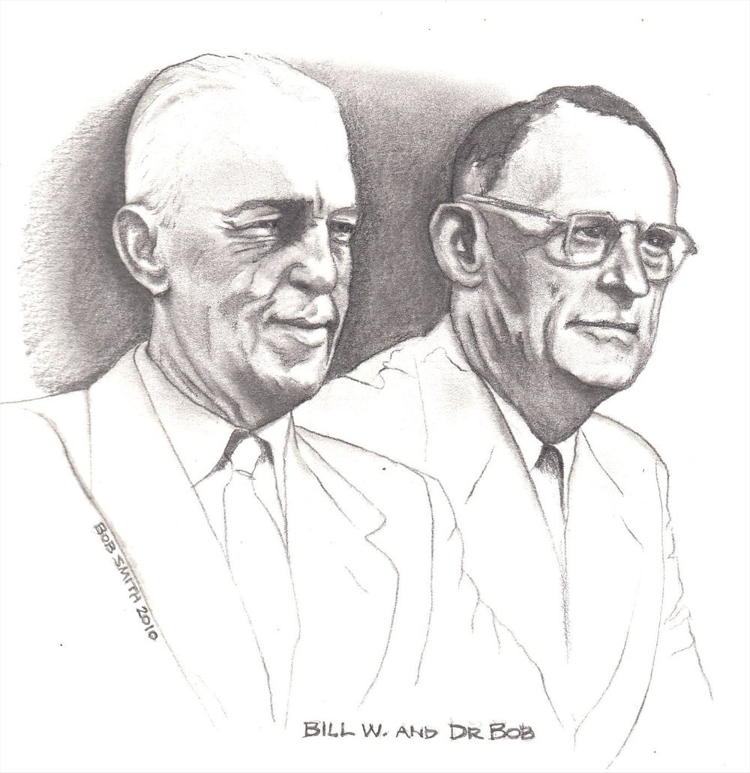
1935
Notes:
AA Founded June 1935.
Bill Wilson and Dr. Robert Smith, known throughout the movement as Bill W and Dr. Bob in the AA tradition* of not publicly using full names.
https://en.wikipedia.org/wiki/Alcoholics_Anonymous
https://en.wikipedia.org/wiki/Dr_Bob
https://en.wikipedia.org/wiki/Bill_W.
* http://www.aa.org/pages/en_US/anonymity-letter-to-media

Slide 3
Flesh out notes.
Notes:
http://www.aa.org/pages/en_US/alcoholics-anonymous

Slide 4
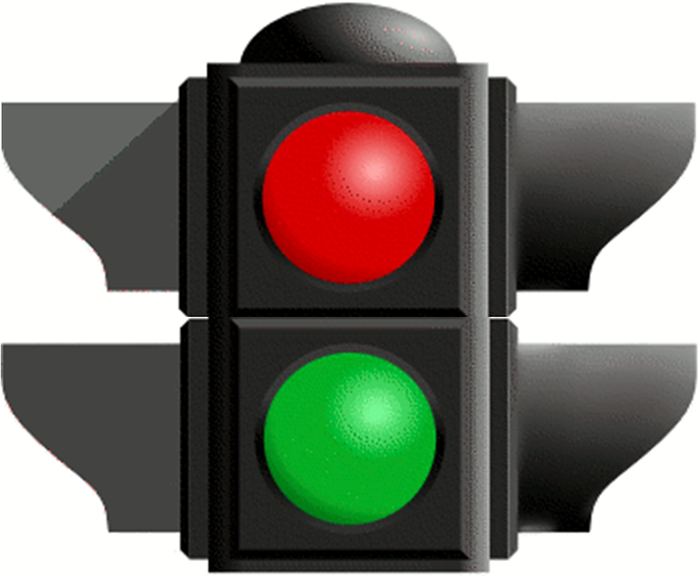
Flesh out notes.
Notes:
By the 1930s and just after prohibition was lifted, U.S. alcohol consumption had almost doubled—per capita consumption grew from 2.7 gallons consumption during Prohibition of absolute alcohol to 5.0. New policies were needed to deal with drunkenness. And the search for a solution shifted away from a broad societal focus like prohibition toward an individual focus like Alcoholics Anonymous (AA), an approach acceptable to the drinks industry.
AA has had a huge influence on the way people in the U.S. still think about problems associated with drinking alcohol. This two-barreled traffic light provides an appropriate image for its influence.
The AA model describes two types of people, alcoholics and non alcoholics. In this image, the red light is on; it represents alcoholics. They have lost control of their ability to drink appropriate amounts and must, therefore, should abstain from alcohol for the rest of their lives.
The green light is off and represents the many unspoken assumptions the model facilitates about people who are not alcoholic. For example, people may assume that if they’re not an alcoholic, they don’t have to concern themselves with how much they drink. In any case AA does not provide any guidance for how much or how often non-alcoholics should or shouldn’t drink.
It is not surprising that many drinkers default to the position of denying that the label alcoholic. In our alcohol SBI programs drinkers are often willing to report that they drink a great deal. Apparently that’s different from accepting a stigmatizing label.
The AA model has a great deal of influence among health care professionals, too.

Slide 5
Notes:
Age of Modern Clinical Science Truly Begins
This is the first published randomized clinical trial, the use of streptomycin to treat TB.
http://www.statsref.com/HTML/index.html?randomized_controlled_trials.html
“This particular trial was the first truly randomized clinical trial” At least the first published trial.
https://en.wikipedia.org/wiki/Randomized_controlled_trial#History
The first published RCT appeared in the 1948 paper entitled "Streptomycin treatment of pulmonary tuberculosis", which described a Medical Research Council investigation.^{[14][15][16]} One of the authors of that paper was Austin Bradford Hill, who is credited as having conceived the modern RCT.^{[17]}
Meldrum ML (2000). "A brief history of the randomized controlled trial. From oranges and lemons to the gold standard". Hematol Oncol Clin North Am 14 (4): 745–60, vii. doi:10.1016/S0889-8588(05)70309-9. PMID 10949771.

Slide 6
U.S. population
100%
Notes:
Over the last 4 decades we’ve studied how much people in the whole U.S. civilian population drink.
Epidemiologic surveys of drinking in the U.S. population started in the 1960s and have continued to the present. These surveys don’t just study alcoholics or an even smaller group—alcoholics who present for specialized treatment. They study the whole population.
They ask questions about how much, how often, and what kinds of beverages people drink. They also ask about the whole range of negative consequences people experience as a result of their drinking.
In this slide each dot represents 1% of the non-institutionalized, civilian population.
The next two slides show the results of the latest epidemiologic surveys.

Slide 7
Drink Too Much
29%
Notes:
29% of the U.S. population drinks too much.

Slide 8
71%
25%
4%
Notes:
25% drinks too much, but is not dependent on alcohol.
4% of the population could support a diagnosis of alcohol dependence.
Notice that the red group and the yellow group add up to 29% of the population that drinks too much.
Note
Most of the 4% have not actually been diagnosed, but surveys predict that their symptoms would support a diagnosis of alcohol dependence. Strictly speaking, not all of the four percent who are dependent may drink too much. This may seem strange, but the diagnosis of alcohol dependence is based on harm and symptoms, and does not require any measurement of alcohol consumption
8

Slide 9
6
1
Notes:
For every 1 person addicted to alcohol (the red number) there are 6 other people who misuse alcohol and are at risk for harm or have already experienced harm as a result of their drinking.
The implications of this are huge. This six-to-one ratio means that even if we could completely cure every single alcoholic in the country, we wouldn’t have cured most of the alcohol-related harm our society will experience.
It’s clear to everyone that you don’t have to be an alcoholic to get hurt from your drinking or to hurt others. Nonetheless, the concept of alcoholism has dominated our thinking about alcohol.
9

Slide 10
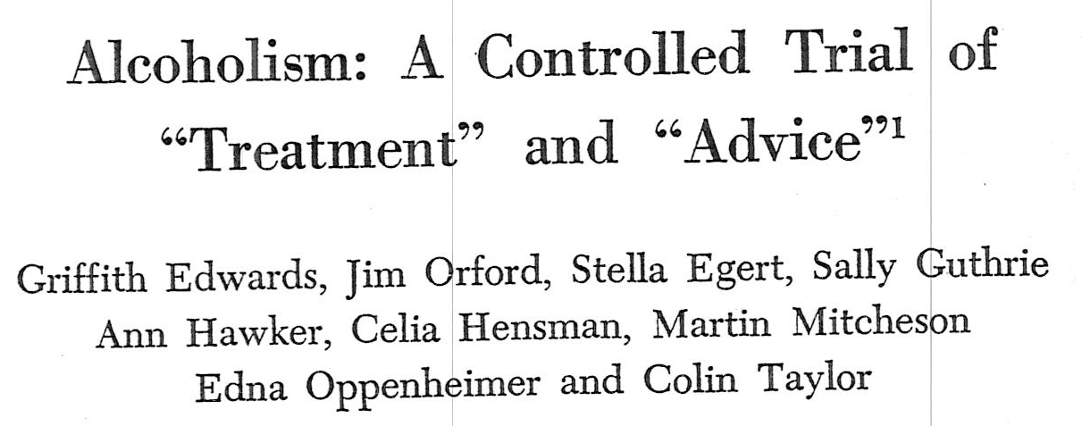
1977
Notes:
This is one of the earliest randomized trials that led to the concept of brief interventions.
The “treatment” group had longer, more intense interventions but no better results than the “advice” group.
A year later, a similar trial in the U.S confirmed these results.

Slide 11
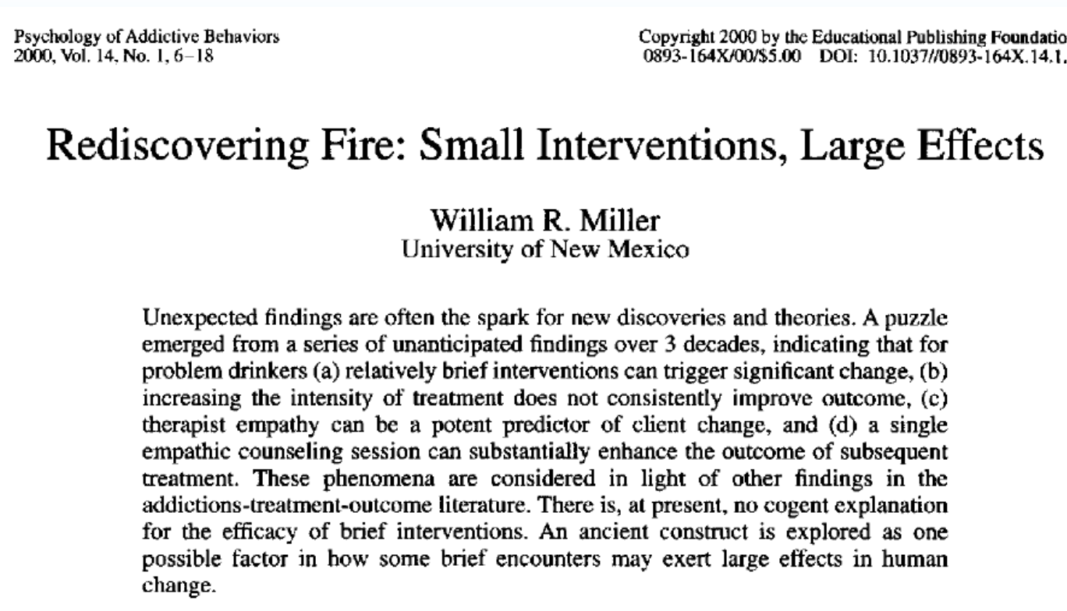
Notes:
This excellent article reviews 30 years of research by the father of brief interventions in the U.S.

Slide 12
Screening & Brief Intervention, Referral to Treatment (SBI/RT)
S ≠ case finding; screen everyone
BI provide onsite; 5 to 30 minutes
R as needed; facilitated; relatively rare
T offsite; use BI to build motivation
Notes:
You can download the WHO Brief Intervention for Hazardous and Harmful Drinking Manual from
http://whqlibdoc.who.int/hq/2001/WHO_MSD_MSB_01.6b.pdf
Screening is different from case finding, which is the prevailing method of identifying patients who are drinking too much or have alcohol-related problems.
In case finding, a clinician evaluates patients who appear to have a medical or psychological condition to arrive at a diagnosis. In case finding, the only patients identified are patients the staff think might have the condition of interest. The goal is diagnosis and the target is the individual patient.
In screening, program staff use a screening instrument with every member of a predefined group of patients to identify and measure risk factors for a condition. Screen-positive patients receive an intervention to decrease that risk. Depending on the
condition and risk factors of interest, screen-positive status may or may not lead to a diagnostic evaluation. The goal is quantifying risk and the target is a prede-fined group.
In most medical clinics, the prevailing practice is case finding, to address alcohol-related problems only for patients who appear to have them. However, this practice does not identify the majority of patients at risk from their drinking because in many alcohol-related conditions, the role of alcohol is not obvious. Another important consideration is the relationship of the screening instrument to the condition of interest. For example, a blood alcohol concentration (BAC) is appropriate to identify the degree to which a patient is intoxicated, and therefore particularly useful in a trauma setting, where the patient may receive a general anesthetic. However, a BAC does not reveal usual alcohol consumption, alcohol-related harm, or
the symptoms of alcohol dependence, all of which can be measured with a self-report questionnaire.
In the research literature, brief intervention is defined many ways and, historically, can include three or four separate counseling sessions. However, brief intervention is typically defined as a post-screening interaction between a patient and specially trained staff who do not need advanced professional counseling credentials. The interaction occurs during the medical visit or hospitalization and can last from 5 minutes to 20 minutes or more. For patients with less severe problems, the intervention usually focuses on motivating patients to decrease or stop drinking. For patients who have severe alcohol-related problems, the focus of the brief intervention may be to increase patients’ motivation to seek more intensive treatment. The brief intervention may also include efforts to ensure patients will be able to access appropriate specialized services.

Slide 13
patient population to be screened
screener
– screen
+ screen
• assess alcohol-related problems
• assess likely alcohol dependence
brochure on drinking limits
brief intervention
referral
Notes:
Screen: does this patient need an intervention, i.e., is the patient drinking too much.
Assess: what type of intervention does this patient need, brief or more intensive?
depth of evidence for alcohol SBI: > 50 RCTs
effect size is typically in the range of 20 to 30%
Therefore, many patients do not respond.
However, as alcohol SBI becomes more common and is provided in multiple settings and to patients in primary care settings, provided multiple times over a few years, patients who don’t respond at first may respond in the future. Think of it as similar to compound interest.
strongest evidence of effect in primary care
Inexpensive to provide, especially compared to treatment of alcohol dependence and the cost of medical care for patients who drink too much.

Slide 14
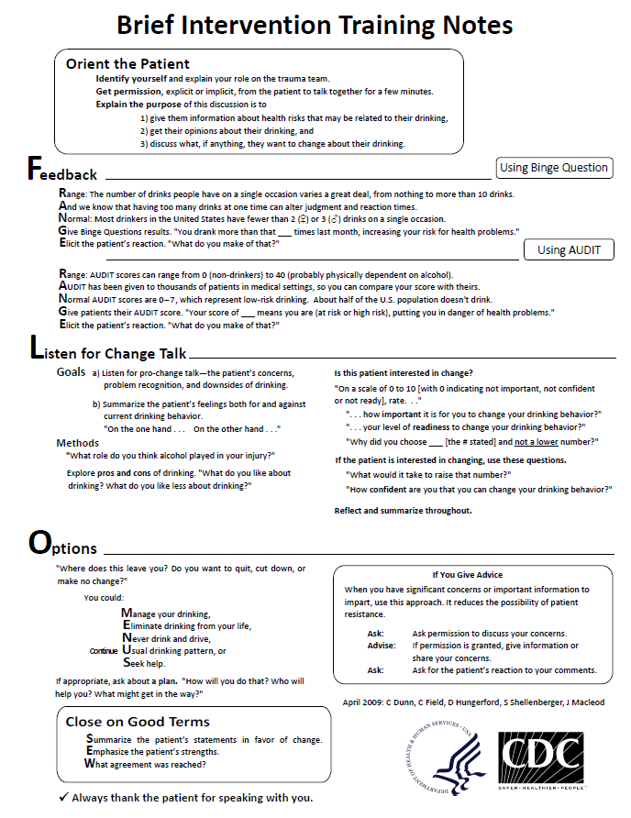
Notes:
These notes summarize brief intervention training provided several years ago in ten regional, day-long sessions around the country for trauma center and emergency department professionals.
If you switch to slide-show mode (shift+F5), he text on this slide is large enough to read.
Soon CDC will publish this as part of Planning and Implementing Screening & Brief Intervention for Risky Alcohol Use: A Step-by-Step Guide for Primary Care Practices.
I will make sure you are emailed a copy.

Slide 15
The spectrum concept is different from the alcoholism concept.
Continuum vs two categories
As the drinking and consequences get more severe, the number of people in each category gets smaller.
In most depictions of the concept, an extremely common, clearly harmful alcohol-related condition— intoxication—tends to be omitted. One need not be addicted to be intoxicated.
The focus on the tip of the pyramid, i.e., that the most severe condition is alcoholism, remains.

Slide 16
Spectrum of Use and Misuse
lifetime abstinence
current abstinence
low risk drinking
hazardous drinking
intoxication
harmful drinking
dependence symptoms
dependence
Notes:
Note: I prepared the following labels and definitions before DSM V was published. At the time generally-accepted theory held that alcohol abuse was a less severe condition than alcohol dependence. Later research showed this assumption to be invalid. Therefore, DSM V dispensed with the two diagnostic categories and labeled the severity continuum substance use disorders. The following definitions
Lifetime abstinence: Individuals in this group have never had more than 12 drinks in a year, and never more than weekly or daily maximum limits.
Current abstinence: Although the drinking patterns of individuals in this group are the same as those in the lifetime-abstinence group at the present time, in the past individuals could have been in one of the other categories, even the dependence category. Therefore, the drinking history of individuals in this group is quite heterogeneous.
Low risk drinking: Individuals in this group drink within the recommended limits, which means they may drink regularly but the amount and frequency of their drink is unlikely to lead to harm.
Hazardous drinking: Individuals in this group drink over the recommended limits. If they continue to drink at this level, epidemiologic evidence indicates that they more likely to experience drinking-related harm than low-risk drinkers.
Harmful drinking: Individuals in this group also drink over the recommended limits. However, they have already experienced harm from their drinking. Their drinking may have fostered a variety of negative consequences—crashing their car, getting into fights, complicating their personal and work relationships, getting into legal trouble, causing health and financial problems. Some of these outcomes are related to drinking too much over a long period of time, such as health problems. These are the chronic outcomes of drinking. Many of the others are related to drinking too much on single occasions, which leads to some level of intoxication and impaired judgment. These are the acute outcomes of drinking.
Dependence symptoms: Individuals in this group experience alcohol dependence symptoms, but no not often enough to warrant a diagnosis of alcohol dependence. Two classic symptoms are 1) being unable to remember what happened the night before the morning after a heavy drinking session and 2) needing a drink to get going the morning after a heavy drinking session.
Dependence: Here is the definition from the International Statistical Classification of Diseases and Related Health Problems 10th Revision (ICD-10).
“A cluster of behavioural, cognitive, and physiological phenomena that develop after repeated substance use and that typically include a strong desire to take the drug, difficulties in controlling its use, persisting in its use despite harmful consequences, a higher priority given to drug use than to other activities and obligations, increased tolerance, anOpd sometimes a physical withdrawal state.”
(World Health Organization. The ICD-10 classification of mental and behavioural disorders: clinical descriptions and diagnostic guidelines. Geneva, Switzerland; 1992.)
Here is the definition from the American Psychiatric Association.
Dependence can vary considerably in severity and in accompanying symptoms. But diagnosis requires experiencing three (or more) of the following symptoms within the same 12-month period:
1) tolerance,
2) withdrawal or drinking to relieve withdrawal,
3) impaired control (i.e., persistent desire or unsuccessful attempts to cut down),
4) drinking more or longer than intended,
5) giving up or reducing important activities because of alcohol use,
6) an excessive amount of time spent in obtaining, using, or recovering from the use of alcohol,
7) continued alcohol use despite recurrent psychological or physical problems.
(American Psychiatric Association. Diagnostic and statistical manual of mental disorders, 4th Edition. Washington DC: APA; 1994.)
Intoxication: The drinking patterns of individuals in the bracketed conditions often lead to intoxication. When intoxication impairs judgment and affects physical control, it can lead to a variety of negative consequences. Nonetheless, intoxication, even extreme intoxication, is not equivalent to alcohol dependence.
Alcoholics get drunk, BUT not everyone who gets drunk is an alcoholic. Although vast majority of college students who get drunk, even on a fairly regular basis, are not alcoholics. Although most of them will mature out of heavy drinking, some will die as a result of their binge drinking long before they ever get the chance to become an alcoholic.
Conversely, many alcoholic individuals are not drunk when they visit their doctor. For that reason, they are usually not identified.
Bottom line: For every alcoholic, there are 6 to 7 individuals who need an intervention. For almost all of them, a brief intervention will be adequate.

Slide 17
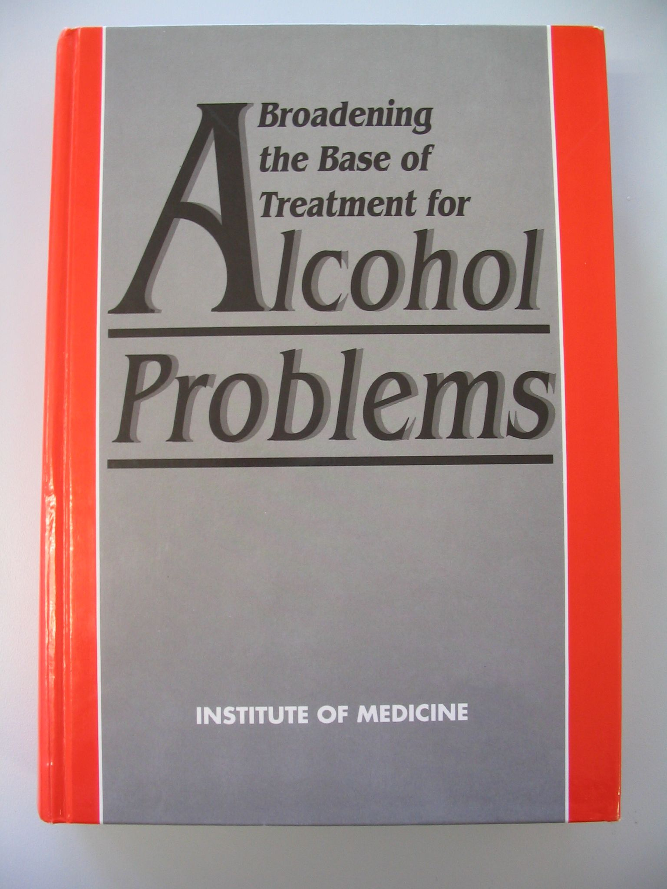
1990
Notes:
By 1990, research on alcohol screening and brief intervention was strong enough for the Institute of Medicine to publish Broadening the Base of Treatment of Alcohol Problems.
It summarized the research to date and based its recommendations on both clinical and epidemiologic research.
It recommended a two-part treatment system.
the already-existing specialized treatment system designed for individuals with severe alcohol problems
a community-based system designed to identify individuals who are drinking too much
The community based system would provide brief interventions for individuals who were not dependent on alcohol and referral to specialized treatment for individuals who were dependent on alcohol or had severe problems.

Slide 18
Broadening the Base of Treatment
From only specialized treatment
severe problems
prior history of dependence,
comorbidity (liver damage, mental illness)
Now includes community interventions
public health screening
in a wide variety of settings
provides brief interventions for patients who don’t need specialized treatment
provides referral to specialized treatment for the small proportion who do need it
IOM, 1990

Slide 19
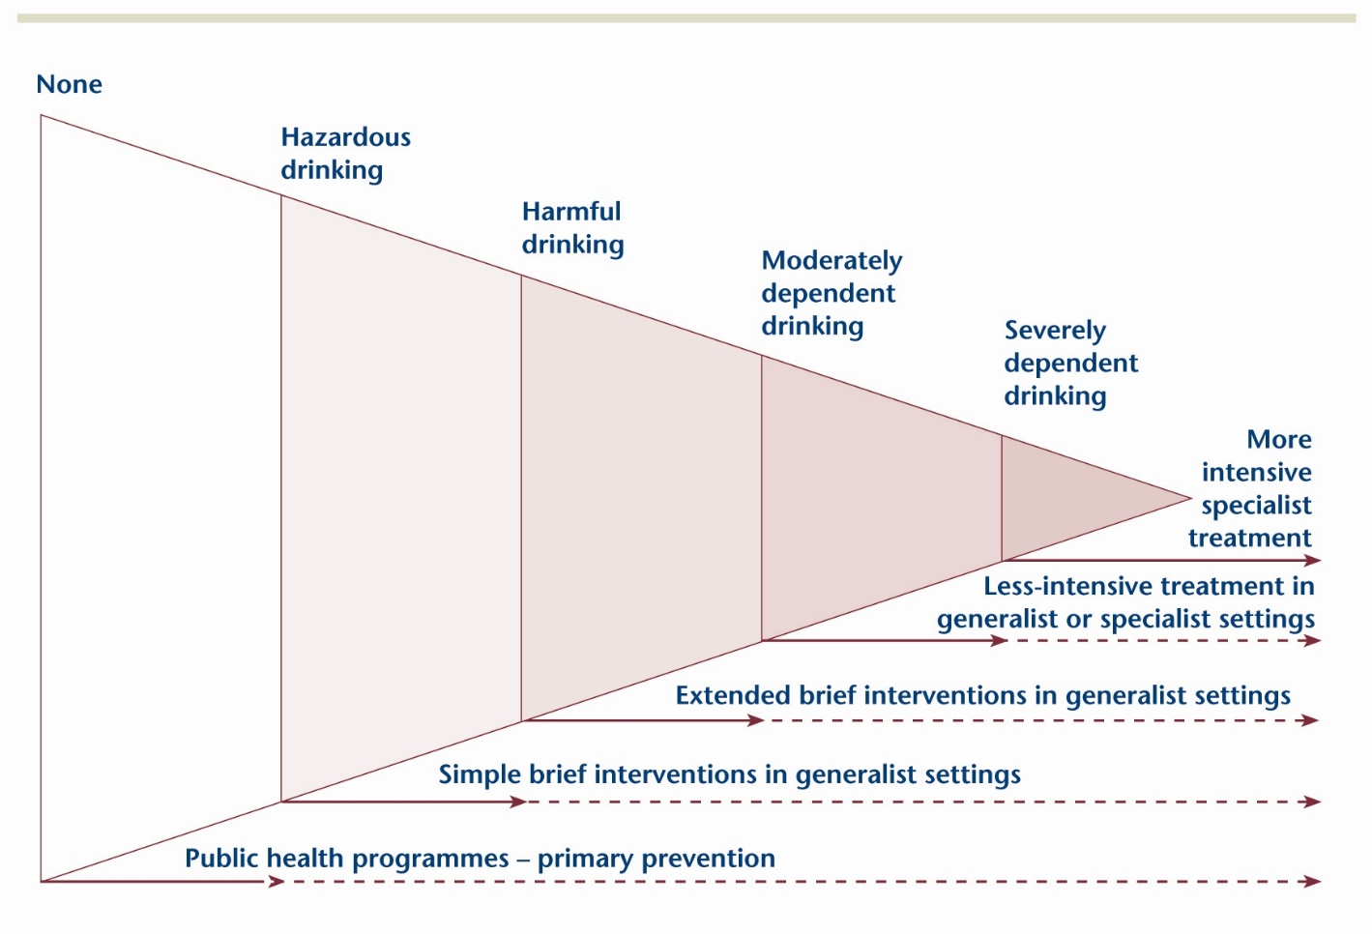
Notes:
http://www.drugsandalcohol.ie/fckeditor_UPLOADS/ image/gallery01/drugnet_21_p19_trends_in_alcohol.jpg
This diagram is an adaptation of the one presented in the IOM publication and is an early example of moving from the two-category system described earlier and a spectrum (or continuous) model.
The spectrum concept is different from the alcoholism concept in that it highlights that drinking and its effects exist on a continuum rather than as two separate categories. Moreover, it shows that as drinking and effects get more severe, the number of people in each category gets smaller.
It is similar to the alcoholism concept in that it focuses on alcoholism as the most severe outcomes.
One problem with most descriptions or depictions of the spectrum concept is that an extremely common, clearly harmful alcohol-related condition — intoxication — tends to be omitted. It’s not clear where that should go on the spectrum because one need not be addicted to be intoxicated.
Figure 2a: A spectrum of responses to alcohol problems
Adapted from figure 9.1 in the Institute of Medicine [1990] report, p212. The triangle shown in figure 2a represents the population of England, with the spectrum of alcohol problems experienced by the population shown along the upper side of the figure. Responses to these problems are shown along the lower side. The dotted lines in figure 2a suggest that primary prevention, simple brief intervention, extended brief intervention and less-intensive treatment may have effects beyond their main target area. Although the figure is not drawn to scale, the prevalence in the population of each of the categories of alcohol problem is approximated by the area of the triangle occupied; most people have no alcohol problems, a very large number show risky consumption but no current problems, many have risky consumption and less serious alcohol problems, some have moderate dependence and problems and a few have severe dependence or complicated alcohol problems.
http://www.nta.nhs.uk/uploads/nta_review_of_the_effectiveness_ of_treatment_for_alcohol_problems_fullreport_2006_alcohol2.pdf

Slide 20
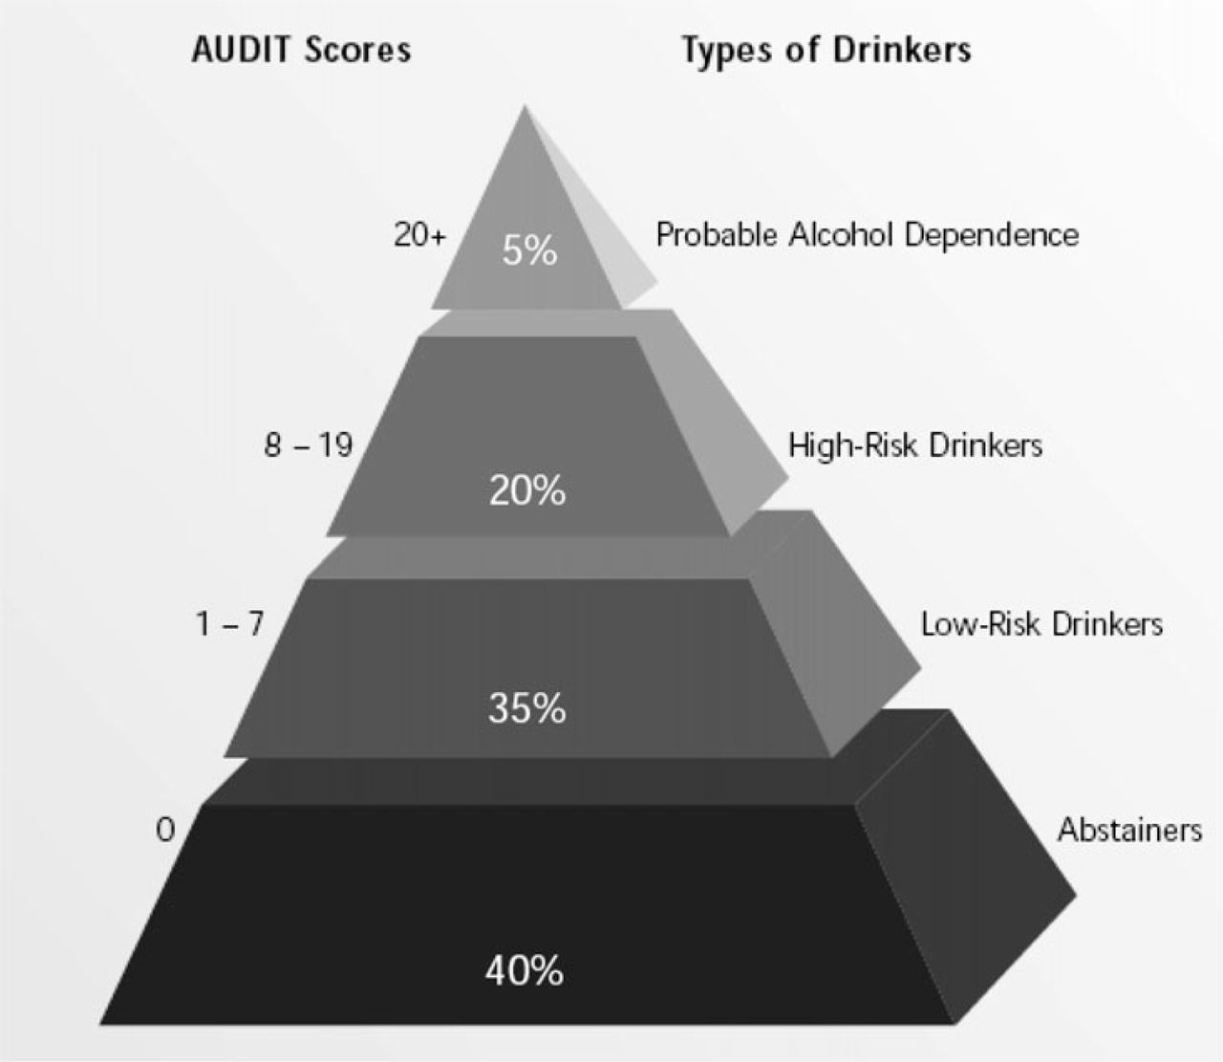
~1995
Notes:
Here is another early depiction of the spectrum concept.
Published in 2001 on p. 33 of WHO’s Brief Intervention manual.
http://whqlibdoc.who.int/hq/2001/WHO_MSD_MSB_01.6b.pdf?ua=1

Slide 21
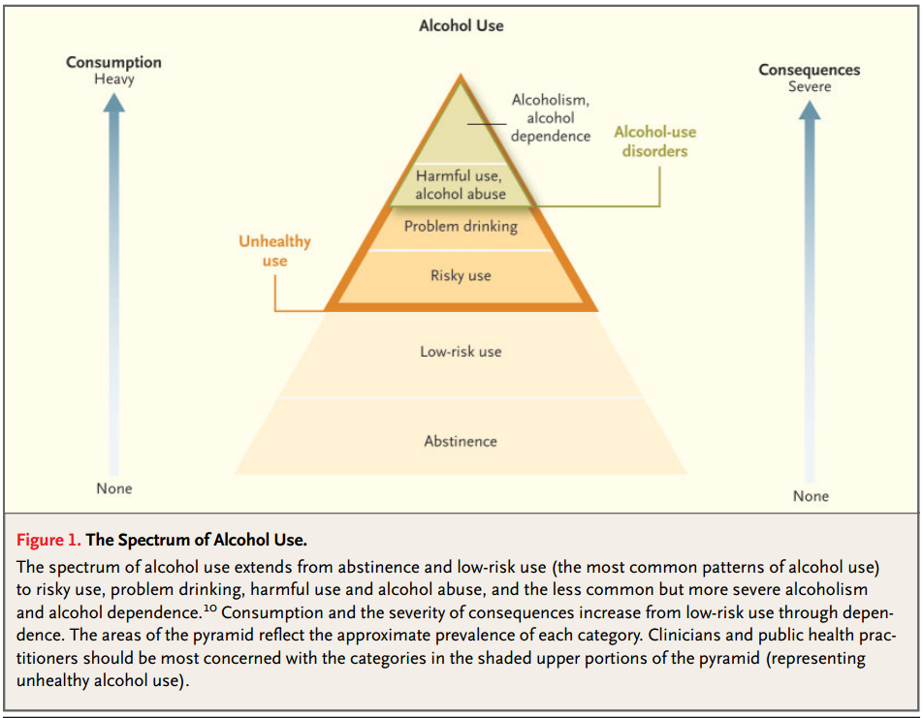
Notes:
Unhealthy Alcohol Use
Richard Saitz, M.D., M.P.H.
N Engl J Med 2005; 352:596-607, Feb 10, 2005.
http://www.nejm.org/doi/full/10.1056/NEJMcp042262
And yet another.

Slide 22
Types of Drinkers
Prevalence in U.S. 2004
Risky Dependent
< 4 %
Risky Nondependent
25%
Moderate & Abstaining
71%
Notes:
A Simplified Spectrum of Alcohol Use
About 70% of the population is at low risk of future harm from their drinking because they don’t drink at all or they don’t drink very much.
The remaining 30% of the population drinks at risky levels. This group can be broken into two categories.
About 4% have very serious alcohol-related problems. They are essentially addicted and could be formally diagnosed as alcohol dependent.
About 25% drink enough to increase risk for future alcohol-related harm or who have already experienced alcohol-related harm. No one in this group, however, is addicted.
Risky Nondependent Drinkers
Drink too much
Many, but not all, have experienced social, legal, physical harm
Are not addicted.
For every alcoholic, there are 6 to 7 individuals who need an intervention. For almost all of them, a brief intervention will be adequate.
I prepared this diagram around 2006 in consultation with Deborah Dawson, an epidemiologist at NIAAA, and using the following two publications.
Grant BF, Dawson DA, Stinson FS, Chou SP, Dufour MC, Pickering RP. The 12-month prevalence and trends in DSM-IV alcohol abuse and dependence: United States, 1991–1992 and 2001–2002. Drug Alcohol Depend. 2004;74:223–234.
Dawson DA, Grant BF, Stinson FS et al. Toward the Attainment of Low-Risk Drinking Goals: A 10-Year Progress Report. Alcohol Clin Exp Res 2004;28:1371-1378.
Alcoholics get drunk, BUT not every person who gets drunk is an alcoholic. Many severely intoxicated ER patients are not alcoholics, but they were drunk when they came to the ER.
Most college students who drink—often regularly and heavily—are not alcoholics. Although most of them will mature out of heavy drinking, some will die as a result of their binge drinking long before they ever get the chance to become an alcoholic.
Conversely, many alcoholic individuals are not drunk when they visit their doctor. For that reason, they are usually not identified.

Slide 23
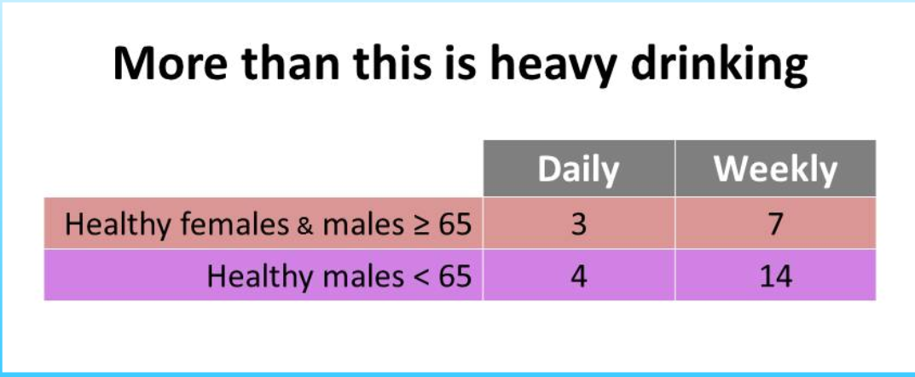
More than Daily or Weekly limits is risky
Notes:
The National Institute on Alcohol Abuse and Alcoholism, one of the national institutes of health, evaluated research and devised these maximum limits for healthy adults.
National Institute on Alcohol Abuse, and Alcoholism. Helping Patients Who Drink Too Much, A Clinicians Guide, Updated 2005 Edition. 2007. Available at http://pubs.niaaa.nih.gov/publications/Practitioner/CliniciansGuide2005/guide.pdf.
Men can drink up to 4 drinks in a day and no more than 14 in a week. Women up to 3 a day and no more than 7 in a week.
Anything more than either limit is considered heavy drinking.
Drinking below these limits does not equal low-risk drinking.
Why they are the limits different for women and older men?
Women
Generally smaller than men
greater % body fat = less lean body tissue. therefore dilute blood alcohol less
metabolize alcohol differently
Women develop dependence symptoms quicker and more severely than men.
Older Men
Increasing body fat
changed metabolism
more meds than when younger

Slide 24
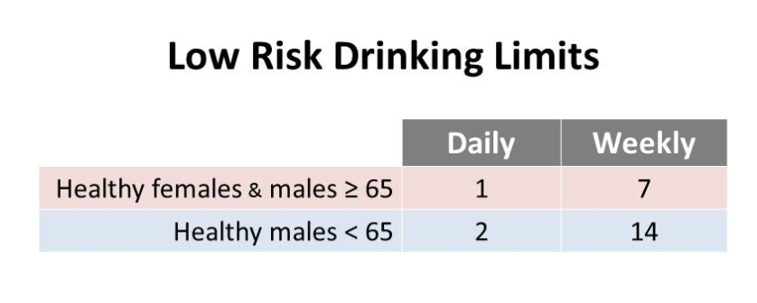
Notes:
The limits on the previous slide are for heavy drinking. The limits on this slide are for low risk drinking.
It is important to understand that at a population level there is no such thing as no-risk limits.
http://www.cnpp.usda.gov/DGAs2010-PolicyDocument.htm
U.S. Department of Agriculture and U.S. Department of Health and Human Services. Dietary Guidelines for Americans, 2010. 7th Edition, Washington, DC: U.S. Government Printing Office, December 2010.
The alcohol section is on pp.30-32 in this document
http://www.cnpp.usda.gov/DGAs2010-PolicyDocument.htm

Slide 25
Even a smaller amount can be risky because alcohol
interacts with some medications, e.g
worsens some medical conditions, e.g., hypertension, GERD
reduces skill, coordination, and alertness (think driving, heavy machinery, flying, etc.
For some people, even less is risky. ^{7,} The levels provided above are just one consideration in defining risky drinking. A variety of health conditions and activities may warrant limiting drinking to even lower levels or not drinking at all. Here are some examples.
Individuals taking prescription or over-the-counter medications that may interact with alcohol and cause harmful reactions^{c} Individuals suffering from medical conditions that may be worsened by alcohol, e.g., liver disease, hypertriglyceridemia, pancreatitis Individuals who are driving, planning to drive, or participating in other activities requiring skill, coordination, and alertness
Notes:
For some people, even less is risky. 7,8
The levels provided in the two previous slides are just one consideration in defining risky drinking. A variety of health conditions and activities may warrant limiting drinking to even lower levels or not drinking at all. Here are some examples.
Individuals taking prescription or over-the-counter medications that may interact with alcohol and cause harmful reactionsd
Individuals suffering from medical conditions that may be worsened by alcohol, e.g., liver disease, hypertriglyceridemia, pancreatitis
Individuals who are driving, planning to drive, or participating in other activities requiring skill, coordination, and alertness
National Institute on Alcohol Abuse, and Alcoholism. Helping Patients Who Drink Too Much: A Clinicians Guide, 2007. Available at http://pubs.niaaa.nih.gov/ publications/Practitioner/CliniciansGuide2005/guide. pdf
U.S. Department of Agriculture and U.S. Department of Health and Human Services. Dietary Guidelines for Americans, 2010. 7th Edition, Washington, DC: U.S. Government Printing Office, 2010.

Slide 26
For some patients, any drinking at all is risky.
if they can’t control the amount they drink
women who are pregnant or might become pregnant
Younger than 21. Or, when it is illegal.
For some people, any drinking at all is risky. Here are some examples.
Individuals unable to control the amount they drink. This group includes people dependent on alcohol^{d} Women who are pregnant or might become pregnant (see Women Who Are Pregnant or Might Become Pregnant below for more information) Individuals younger than age 21
Notes:
For some people, any drinking at all is risky.
Here are some examples.
Individuals unable to control the amount they drink. This group includes people dependent on alcohol.*
Women who are pregnant or might become pregnant (see Women Who Are Pregnant or Might Become Pregnant on the next page for more information)
Individuals younger than age 21
* Diagnostic procedures for alcohol use disorders (DSM IV, DSM V) do not generally involve an attempt to quantify how much patients are drinking. Instead, they evaluate the extent to which patients have experienced acute and chronic health or social problems that can be attributed to their drinking. Nonetheless, patients with these diagnoses typically drink above the risky drinking guidelines. For example, epidemiologic research has shown that US adults who meet either the single day or weekly risky drinking levels described above are much more likely to have an alcohol use disorder than patients who do not.

Slide 27
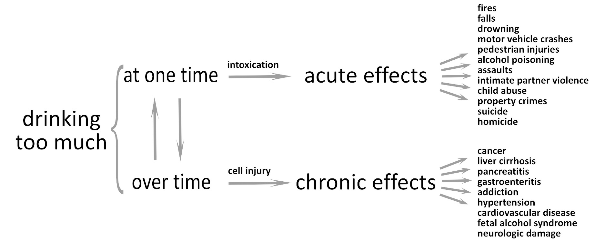
Notes:
I created this figure in 2010 and it was first published here:
Cole S, Bogenschutz M, Hungerford D (2011). Motivational Interviewing and Psychiatry: Use in addiction treatment, risky drinking and routine practice. FOCUS, 9:42-54.
This version includes more effect conditions than the original, and I will be adding risky sex to the list of acute effects in the next version I present.
I originally devised this version to help explain why NIAAA had set out two thresholds for heavy drinking: daily and weekly limits.
The acute effects are mediated through intoxication, which affects the brain. It impairs judgment, increases risk taking behavior, and decreases control of the body, e.g., reaction time, accuracy of movement.
The chronic effects are mediated through injury to cells in tissues throughout the body. Alcohol is a toxic molecule. Chronic exposure to it degrades the function of tissues throughout the body and can lead to a wide variety of health conditions.
One of the advantages of this depiction is that it illustrates the wide variety of health outcomes associated with excessive drinking.
Risky drinking is not just an addiction issue, it’s a major health issue. Knowing how much patients drink should be a routine part of standard medical care.

Slide 28
What is the Problem?
Then: Are you an alcoholic?
Now: Are you drinking too much?
Notes:
This is the paradigm shift that is needed.

Slide 29
Notes:
Full Slide Presentation at http://nirn.fpg.unc.edu/sites/nirn.fpg.unc.edu/files/resources/NIRN-CII-ImplementationAndPublicPolicy-12-2012.pdf
National Implementation Research Network website at http://nirn.fpg.unc.edu/

Slide 30
 | Prevailing Model | Expanded Model
Goal | find addicted drinkers | find patients who drink too much
Method | clinical suspicion | validated instrument, used routinely
Result | diagnosis (0/1) | rank level of risk
Treatment | specialized treatment | brief & specialized treatment
When identified | later | Earlier
Cost | Expensive | Inexpensive
Accessibility | later & elsewhere | onsite & immediate

Slide 31
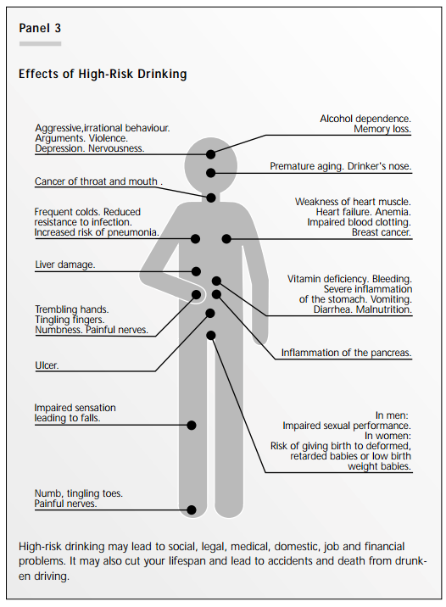
Notes:
Published on p. 34 of WHO’s Brief Intervention manual.
http://whqlibdoc.who.int/hq/2001/WHO_MSD_MSB_01.6b.pdf?ua=1

Slide 32
Alcohol & Health
 | Protects | Harms
Accidents | No | Yes
Violence | No | Yes
Suicide | No | Yes
Fetal effects | No | Yes
Psychiatric disorders | No | Yes
Cancer | No | Yes
Neurological effects | No | Yes
Cardiovascular disease | at > 50 years? | Yes
Swedish Medical Research Council
Notes:
This is a summary from a consensus conference on this topic sponsored by the Swedish Medical Research Council.
From
Allebeck, P. and Rydberg, U. Risks and protective effects of alcohol on the individual. Alcoholism: Clinical and Experimental Research. 1998; 22(7):269S.

Slide 33
Alcohol SBI Model
Population | Intervention | Drinking Goal
Dependent drinkers | specialty treatment | abstinence
Risky, nondependent drinkers | brief | decrease or stop
low risk drinkers & nondrinkers | bibliotherapy | drink under limits

Slide 34
Risky Drinking and Injury
excessive alcohol consumption
cognitive function
coordination
risk taking
risk of injury
severity of injury
chance of survival

Slide 35
National Commission on Prevention Priorities Ranks Preventive Services
Short Name | Health Impact | CE | TOTAL
Discuss Daily Aspirin Use | 5 | 5 | 10
Childhood Vaccination Series | 5 | 5 | 10
Tobacco Cessation Counseling | 5 | 5 | 10
Alcohol Screening & Brief Intervention | 4 | 5 | 9
Colorectal Cancer Screening | 4 | 4 | 8
Hypertension Screening | 5 | 3 | 8
Influenza Immunization – older adults | 4 | 4 | 8
Vision Screening – older adults | 3 | 5 | 8
Notes:
The National Commission on Prevention Priorities ranked 25 preventive clinical services. Seventeen received lower rankings than the 8 in this table.
All listed services have received an A or B ranking from the US Preventive Services Task Force.
All 25 can be viewed at:
http://www.prevent.org/National-Commission-on-Prevention-Priorities/Rankings-of-Preventive-Services-for-the-US-Population.aspx
Health Impact
Clinically preventable burden is a measure of potential impact. It represents a ranking of the disease, injury and premature death prevented if the service is delivered to the full target population.
CE (cost effectiveness) creates a standard measure to compare services for return on investment.
Services with the same total score tied in the rankings:
10 = highest impact, most cost effective among these evidence-based preventive services
2 = lowest impact, least cost effective among these evidence-based preventive services

