Slide 1
The Future of Hospital SBIRT
BIG Hospital Initiative
Steering Committee: August 7 2-3pm EDT
All Committee: August 20 2-3 pm EDT
Eric Goplerud, Ph.D.
Senior Vice President
Director, Substance Abuse, Mental Health and Criminal Justice Studies
goplerud-eric@norc.org
301-634-9525

Slide 2
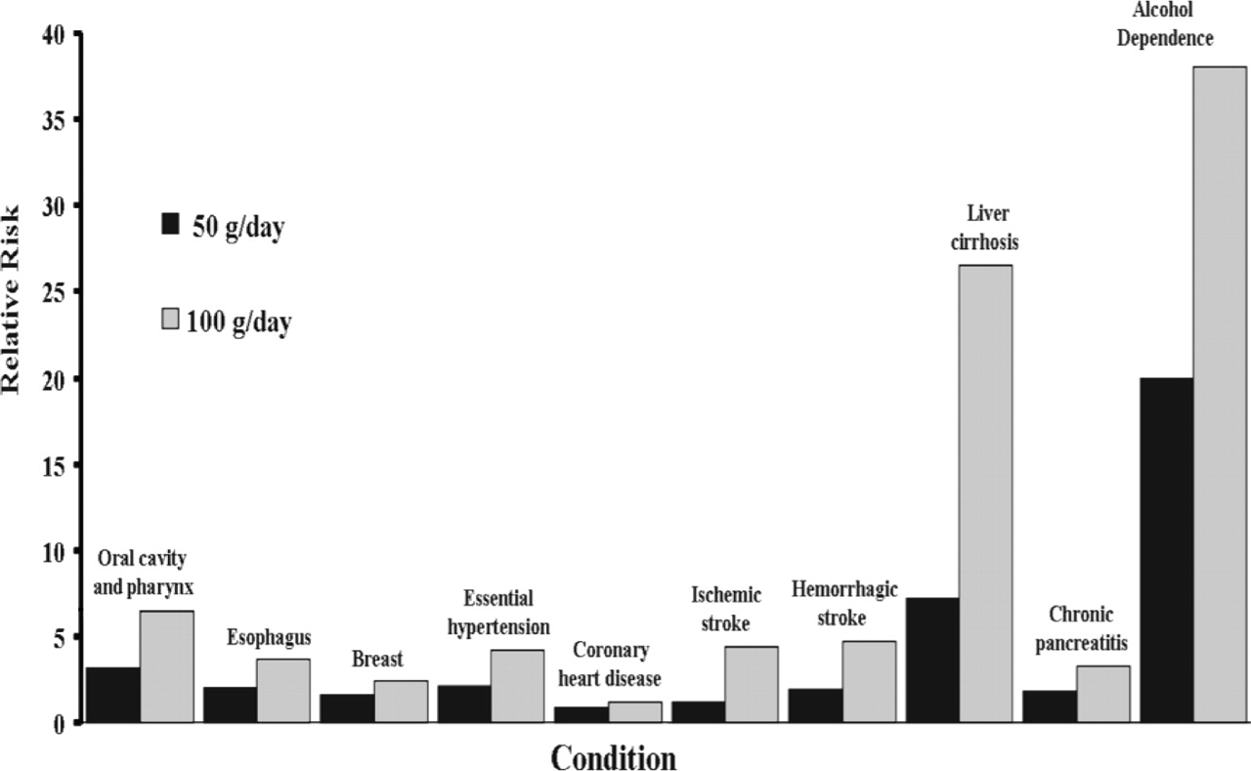
Substance Use Disorders and Risky Substance Use:
Significant Public Health Problem
Excess mortality:
  98,334 deaths annually from alcohol-related causes
  16,044 deaths annually from illicit drugs
  20,044 overdose deaths from controlled prescription drug
Excess morbidity
Mokdad, A. H., Marks, J. S., Stroup, D. F., & Gerberding, J. L. (2004). Actual causes of death in the United States, 2000. JAMA, 291(10), 1238-1245. Relative Risk of an Alcohol-Related Health Condition as a Function of Daily Alcohol Intake (a) adapted from Corrao et al. (2004). Preventive Medicine 38, 613–619. (b) National Institute on Alcohol Abuse and Alcoholism, National Epidemiological Survey on Alcohol and Related Conditions, 2001–2002

Slide 3
Public health problem,certainly.
But why hospitals?
SUDs are public health issues, but how do SUDs impact hospitals?
  Alcohol, drugs, and increasingly, prescription drug use are crowding Emergency Departments
  Expensive ED visits, especially for uncompensated care and returning ED visits by uninsured
  Common complicating problem of hospitalized patients
    Medical complications (MICU, return to surgery, longer length of stays)
    Unstable discharges, rehospitalization

Slide 4
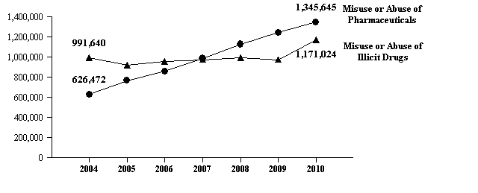
Why Hospital SBIRT: Drug-Related Emergency Department Visits: 2004 to 2010
SOURCE: Adapted by CESAR from Substance Abuse and Mental health Services Administration (SAMHSA), “Highlights of the 2010 Drug Abuse Warning Network (DAWN) Findings on Drug-Related Emergency Department Visits,” The DAWN Report, July 2, 2012. Available online at http://www.samhsa.gov/data/2k12/DAWN096/SR096EDHighlights2010.pdf.
Notes:
Rockett, I. R., S. L. Putnam, et al. (2003). "Assessing substance abuse treatment need: a statewide hospital emergency department study.[see comment]." Annals of Emergency Medicine 41(6): 802-13.

Slide 5
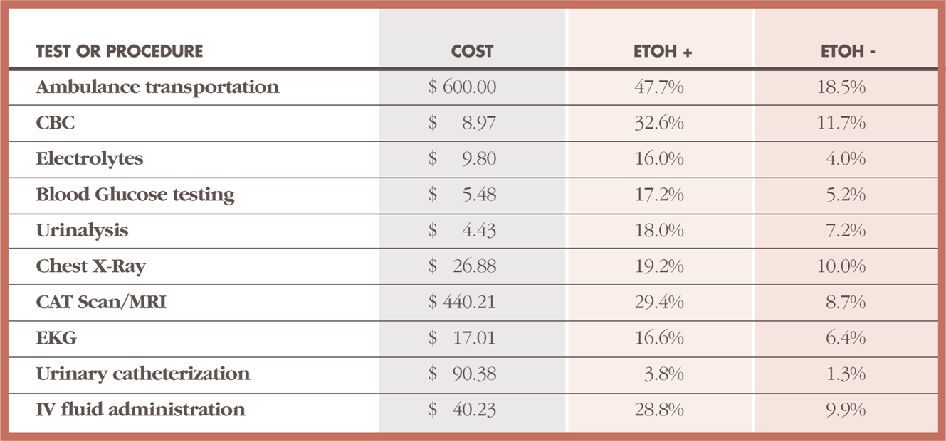
Why Hospital SBIRT: Costly Patients in the ED
Excess ED Costs -- $248 million annually
SOURCE: Terence O'Keeffe, Shahid Shafi, Jason L. Sperry, and Larry M. Gentilello The implications of alcohol intoxication and the Uniform Policy Provision Law on trauma centers; a national trauma data bank analysis of minimally injured patients. J Trauma. 2009 February; 66(2): 495–498.

Slide 6
Why Hospital SBIRT? Example in Colorado of ED Visits Likely Positive for Risky Substance Use, Costs & Savings*
 | Likely to Screen Positive | Annual Costs Undetected | Savings if Detected
All Payers ED Visits | 123,398 | $175,101,664 | $35,328,918
Insurance ED Visits | 34,405 | $ 61,030,664 | $12,077,104
Medicaid ED Visits | 18,183 | $ 32,253,864 | $ 6,382,385
Medicare ED Visits | 4,941 | $ 8,763,843 | $ 1,734,240
Uninsured ED Visits | 43,120 | $ 76,848,444 | $15,135,188
Charity/bad debt
* Of 1,045,155 ED visits 2006; Schur, Goplerud (2007) Estimating the costs and benefits of routine emergency department SBI.
Notes:
Effectiveness of intervention in reducing recidivism and recidivism probabilities
Reduction in repeat ED use (hazard ratio) 0.53
Reduction in repeat hospitalization (hazard ratio) 0.52
Relative risk of repeat injury caused by alcohol problems (problem drinkers vs. not) 2.5
Proportion of intoxicated or injured problem drinkers with subsequent injury requiring ED or hospitalization within 1 year (no intervention) 0.28
Proportion of injured problem drinkers with subsequent ED use (among persons receiving intervention) 0.13
Proportion of injured problem drinkers with subsequent hospital use (among persons receiving intervention) 0.13
Probability of subsequent ED use among those screening negative 0.112
Alcohol-Related Car Crashes
Frequency of crashes among those screening positive for alcohol use/abuse 0.097 ¹³
Cost of property damage only cost 0.561 $2,928 ¹⁴
Cost of injury crashes 0.439 $26,951 ¹⁴
decrease after SBI 0.324 ¹⁵
Criminal Justice Costs Frequency of events among those screening positive 0.037 ¹⁵ Decrease after SBI 0.642 $327 ^{15, 16}

Slide 7
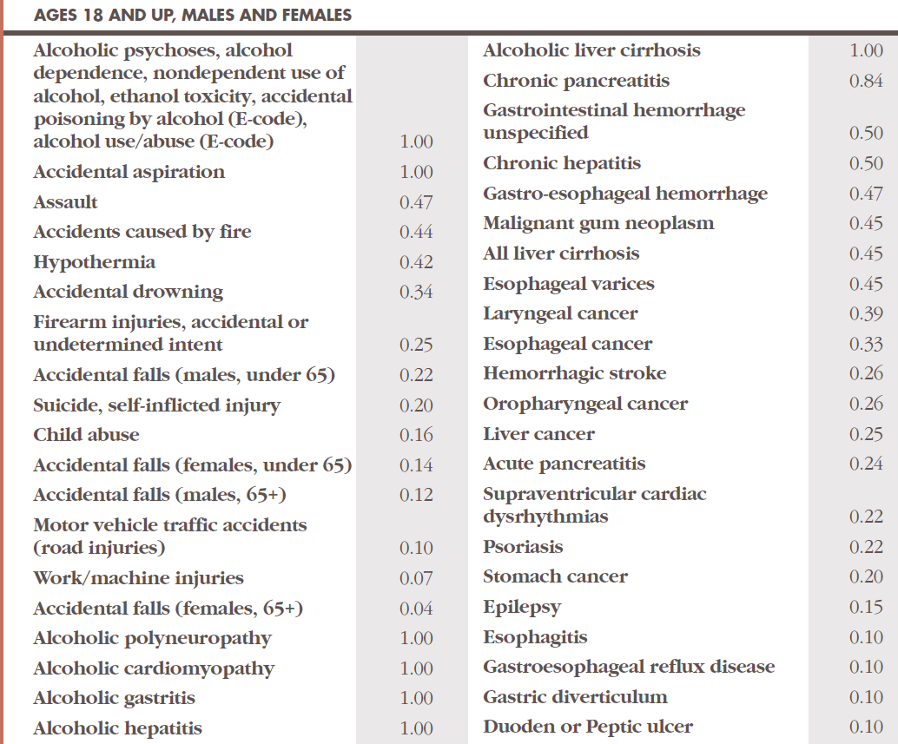
Why Hospital SBIRT?
Problem Drinking Causes Disease and Injury
Under
35 Yrs
Over
35
yrs
SOURCE: Centers for Disease Control and Prevention. (2008a). Alcohol and public health: Alcohol-Related Disease Impact (ARDI).

Slide 8
Prevalence Colorado Inpatients with SUDs or Unhealthy Use by Payer
 | Total hospital discharges | Medicare 32% | Medicaid 12% | Self pay 8% | Insurance 42% | Other, charity 6%
Colorado Inpatient Discharges 2009 | 349,613 | 111,876 | 41,954 | 27,969 | 146,837 | 20,977
Colorado Inpatients with likely substance use disorders | 22,725 | 2,363 | 2,550 | 3,054 | 8,552 | 2,291
Colorado Inpatients with likely SUDs or unhealthy substance use | 48,946 | 5,090 | 5,492 | 6,578 | 18,419 | 4,934
Bad Debt, Charity Care

Slide 9
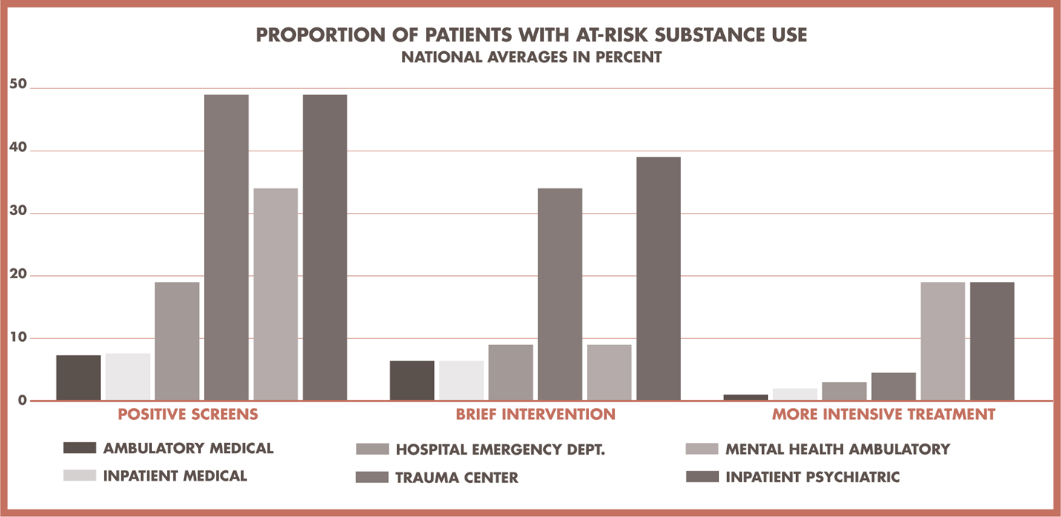
Concentrated substance use risk in specific hospital services
Notes:
Explain your estimates and what it means for the audience.
Positive Screens BI Needed TX Needed
Ambulatory Medical 8% 6% 1%
Inpatient Medical 8% 6% 2%
Hospital Emergency Dept 20% 10% 3%
Trauma Center 50% 35% 5%
Mental Health Amb 35% 10% 20%
Inpatient Psychiatric 50% 40% 20%
Saitz R, Freedner N, Palfai T et al The severity of unhealthy alcohol use in hospitalized medical patients: the spectrum is narrow. J Gen Intern med 2006: 21:381-385
14% of med surg patients scored in risky drinking (>8 on AUDIT); 6.5% high risk (>20 on AUDIT).
Smithers BA, Yahr HT, Ruhl CE. Detectin of alcohol use disorder in general hospital admissions in the United States. Arch Intern Med. 2004;164:749-756.
Hospital admissions diagnosis 0.4% primary diagnosis alcohol abuse dependence, . Rate of diagnosis by research interviews was 7%, by record documentation, 4%. Alcohol abuse or dependence diagnoses (all listed) documented in 40% of interview-positive admissions, and alcohol psychiatric disorder (all listed) in 40%. Of current drinkers admitted to hospital, 24% met interview diagnosis of AUDs.

Slide 10
Consequences that matter to hospitals
Unstable discharges, rehospitalization risk

Slide 11
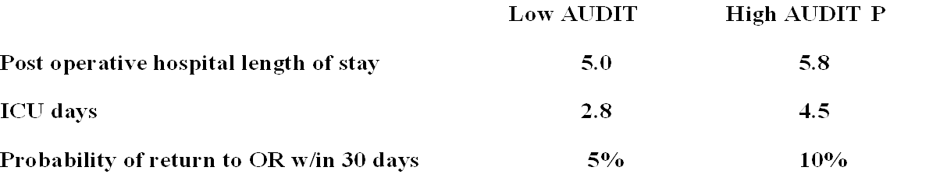
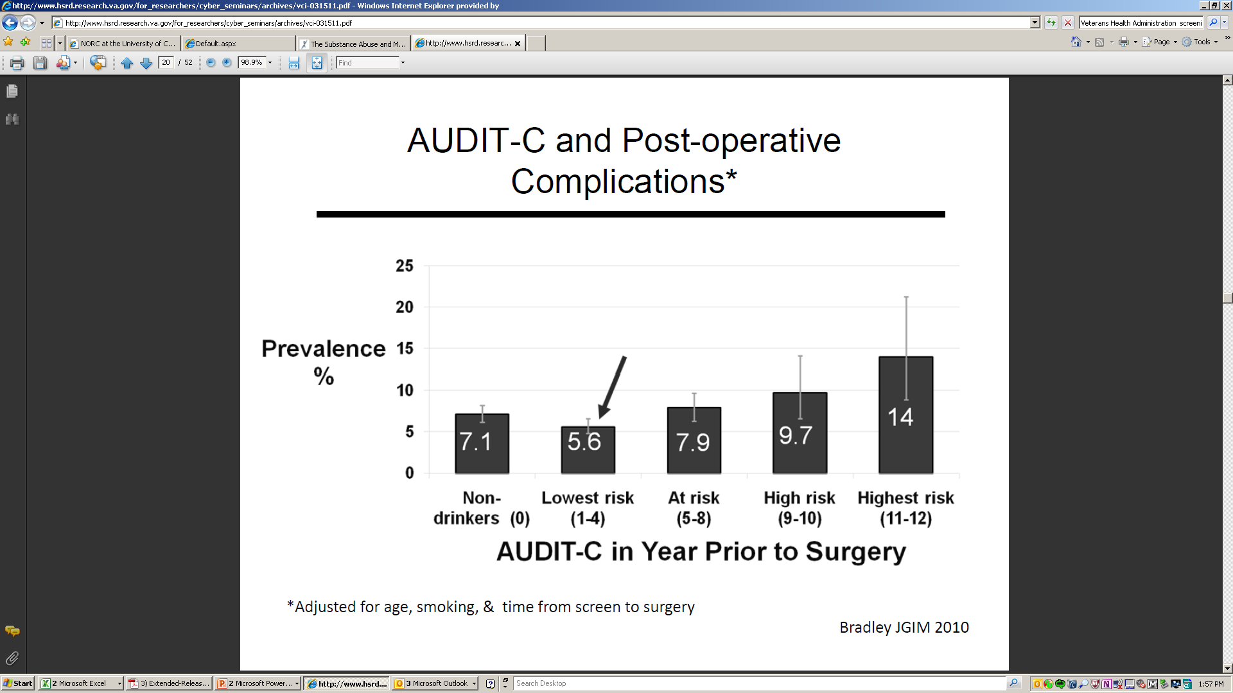
Consequences that matter to hospitals
Surgical complications, infection risk, longer hospital stays, return to MICU and surgery

Slide 12
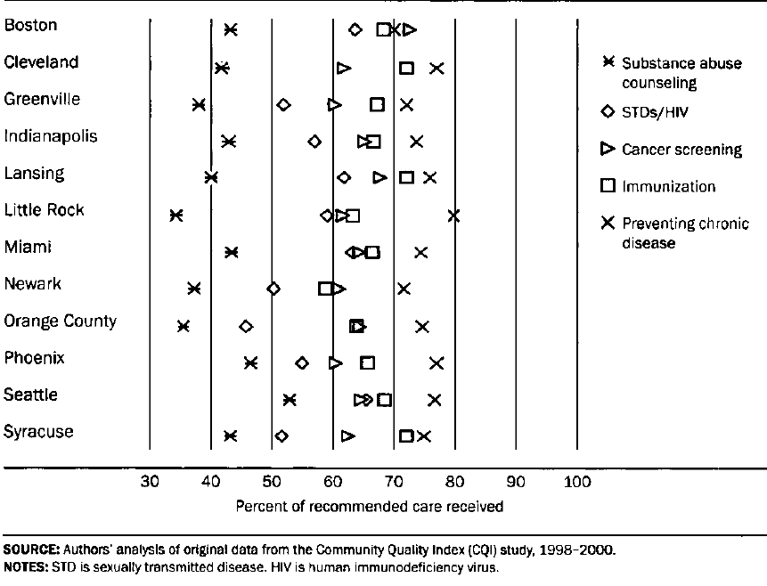
Huge Gap between Current and Evidence-based Practices
SOURCE: Kerr EA, McGlynn EA et al. Profiling the quality of care in 12 communities: Results from the CQI study. Health Affairs. 2004; 23(3): 247-56.

Slide 13
Current and Near Future Developments in Hospital SBIRT
EBPs growing from research and practice experience
Reimbursement base improving
Training and practice support networks strengthening
Accreditation requirements
Performance Metrics and Incentives to Report
Electronic Health Records (EHRs) and Health Information Exchanges (HIEs)

Slide 14
Screening, Brief Interventions for Alcohol:
Major Impact of SBI on Morbidity and Mortality
Study | Results - conclusions | Reference
Trauma patients | 48% fewer re-injury (18 months) 50% less likely to re-hospitalize | Gentilello et al, 1999
Hospital ER screening | Reduced DUI arrests 1 DUI arrest prevented for 9 screens | Schermer et al, 2006
Physician offices | 20% fewer motor vehicle crashes over 48 month follow-up | Fleming et al, 2002
Meta-analysis | Interventions reduced mortality | Cuijpers et al, 2004
Meta-analysis | Treatment reduced alcohol, drug use Positive social outcomes: substance-related work or academic impairment, physical symptoms (e.g., memory loss, injuries) or legal problems (e.g., driving under the influence) | Burke et al, 2003
Meta-analysis | Interventions can provide effective public health approach to reducing risky use. | Whitlock et al, 2004
Notes:
References

Slide 15
Screening, Brief Interventions for Alcohol:
Saves Healthcare Costs
Study | Cost Savings | Reference
Randomized trial of brief treatment in the UK | Reductions in one-year healthcare costs $2.30 cost savings for each $1.00 spent in intervention | UKATT, 2005
Project TREAT (Trial for Early Alcohol Treatment) randomized clinical trial: Screening, brief counseling in 64 primary care clinics of nondependent alcohol misuse | Reductions in future healthcare costs $4.30 cost savings for each $1.00 spent in intervention (48-month follow-up) | Fleming et al, 2003)
Randomized control trial of SBI in a Level I trauma center Alcohol screening and counseling for trauma patients (>700 patients). | Reductions in medical costs $3.81 cost savings for each $1.00 spent in intervention. | Gentilello et al, 2005
Notes:
Some references on cost-effectiveness of SBI.

Slide 16
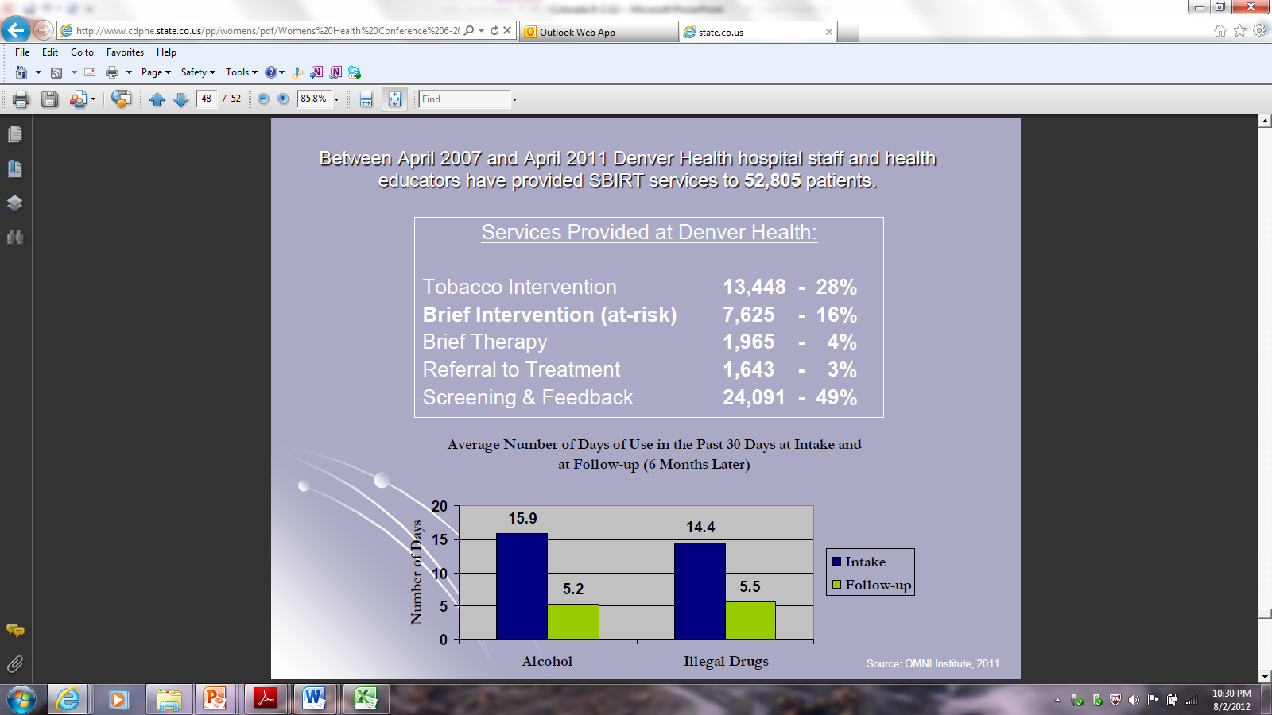
Practice-based SBIRT Outcomes:
Denver Health

Slide 17
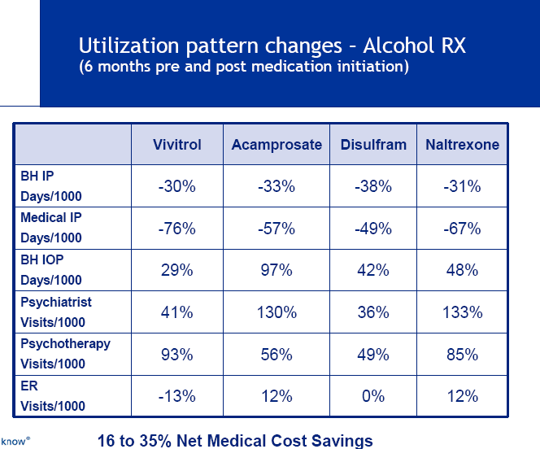
Effectiveness of medical treatment of substance use that convinces payers: Data from a major health insurer’s claims

Slide 18
Baser O, Chalk M, Fiellin DA, Gastfriend DR. Alcohol dependence treatments: comprehensive healthcare costs, utilization outcomes, and pharmacotherapy persistence. Am J Manag Care. 2011:17(8);S222-234.

Slide 19
Baser O, Chalk M, Fiellin DA, Gastfriend DR. Alcohol dependence treatments: comprehensive healthcare costs, utilization outcomes, and pharmacotherapy persistence. Am J Manag Care. 2011:17(8);S222-234.

Slide 20
Baser O, Chalk M, Fiellin DA, Gastfriend DR. Alcohol dependence treatments: comprehensive healthcare costs, utilization outcomes, and pharmacotherapy persistence. Am J Manag Care. 2011:17(8);S222-234.

Slide 21
Baser O, Chalk M, Fielin DA, Gastfriend DR. Cost and utilization outcomes of opioid-dependence treatments. Am J Managed Care, 2011:17(6);S235-248.
Notes:
Retrospective database analysis using commercial enrollees from large US health plan and PharMetrics Integrated Database from 2005-2009.

Slide 22
Baser O, Chalk M, Fielin DA, Gastfriend DR. Cost and utilization outcomes of opioid-dependence treatments. Am J Managed Care, 2011:17(6);S235-248.

Slide 23
Baser O, Chalk M, Fielin DA, Gastfriend DR. Cost and utilization outcomes of opioid-dependence treatments. Am J Managed Care, 2011:17(6);S235-248.

Slide 24
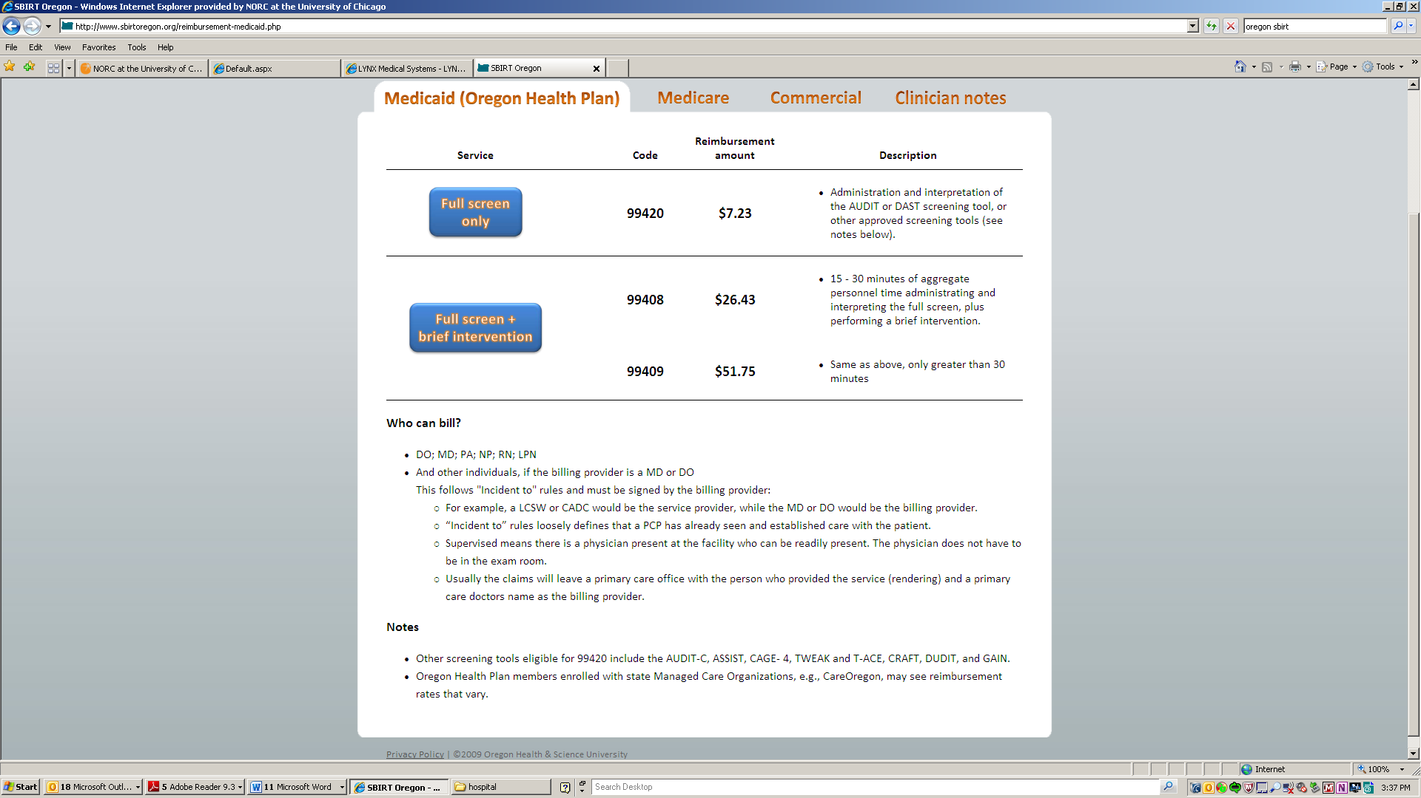
SBIRT Reimbursement: Improving
http://www.sbirtoregon.org/

Slide 25
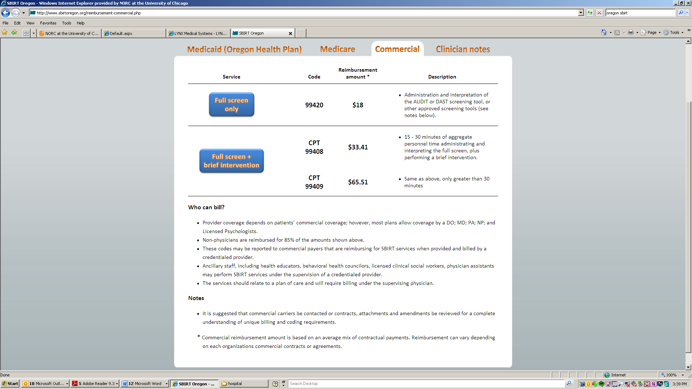
Reimbursement: Improving
http://www.sbirtoregon.org/

Slide 26
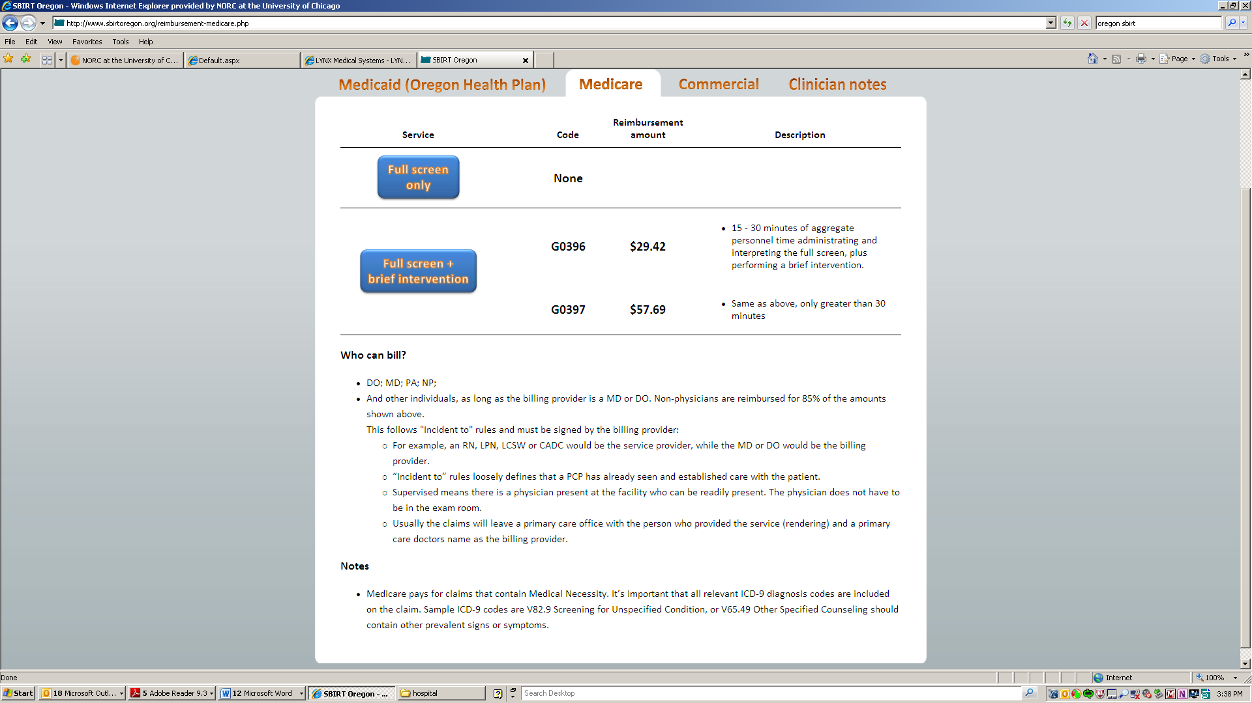
Reimbursement: Improving
http://www.sbirtoregon.org/

Slide 27
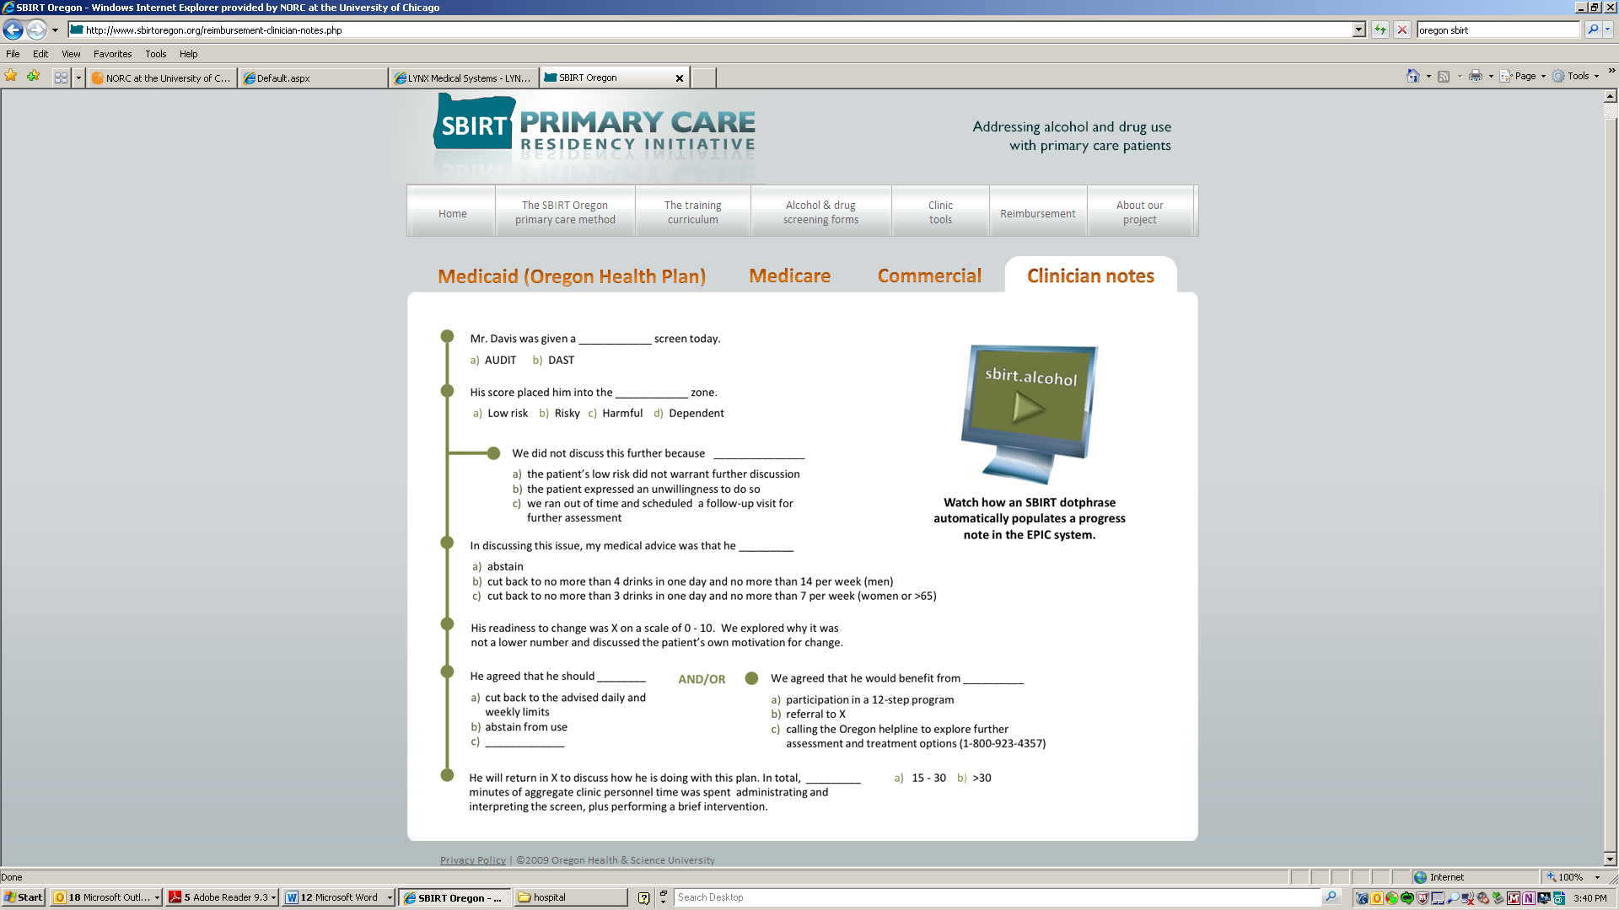
Integrating reimbursement into electronic health records
Oregon Health Sciences University EPIC
http://www.sbirtoregon.org/

Slide 28
Other Hospital SBIRT Reimbursement Supports
Payer | Code | Description | ED Fee Schedule
Commercial Insurance, Medicaid | 99408 | Alcohol and/or substance abuse structured screening and brief intervention services; 15 to 30min | $85
Commercial Insurance, Medicaid | 99409 | Alcohol and/or substance abuse structured screening and brief intervention services; greater than 30min | $185
Medicare | G0396 | Alcohol and/or substance abuse structured screening and brief intervention services; 15 to 30min | $32
Medicare | G0397 | Alcohol and/or substance abuse structured screening and brief intervention services; greater than 30min | $65
Medicare | G0442 | Prevention: Screening for alcohol misuse in adults including pregnant women once per year. (outpatient) No coinsurance; no deductible for patient www.cms.gov/medicare-coverage-database/details/nca-decision-memo.aspx | $17
Medicare | G0443 | Prevention: Up to four, 15 minute, brief face-to-face behavioral counseling interventions per year for individuals, including pregnant women, who screen positive for alcohol misuse; No coinsurance; no deductible for patient (outpatient) http://www.cms.hhs.gov/medicare-coverage-database/details/nca-decision-memo.aspx?NCAId=249 | $25
Medicaid | H0049 | Alcohol and/or drug screening (code not widely used) | $24.00
Medicaid | H0050 | Alcohol and/or drug service, brief intervention, per 15 min (code not widely used) | $48.00

Slide 29

Training and implementation support networks
BIG (Brief Intervention Group) Hospital Network
  Collaborative
  More than 200 hospitals participating
  TA & Training & Mutual Support
  Monthly calls 218-339-4600 426443#
    August 20, 2012 from 2pm - 3pm EST
    September 17, 2012 from 2pm - 3pm EST
  Eric Goplerud – 301-634-9525 goplerud-eric@norc.org
  http//hospitalsbirt.webs.com

Slide 30

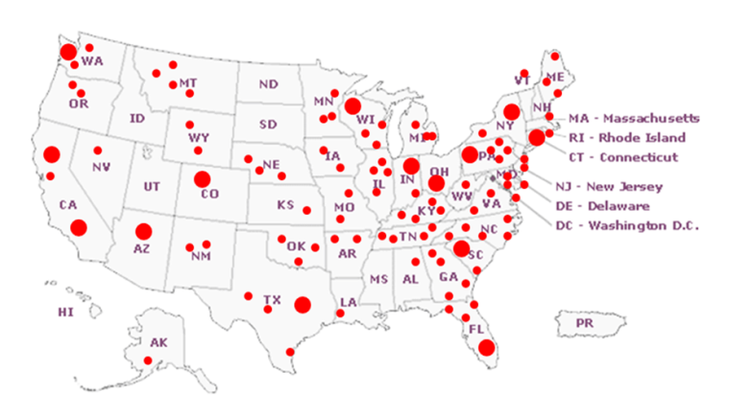
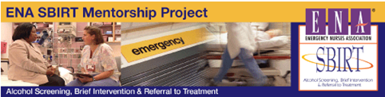
Training and implementation support networks
SAMHSA SBIRT grantees
  21 states, 17 medical residency training, 15 college campus
  SBIRT Colorado – Brie Reimann 303.369.0039 x245
Emergency Nurses Assn SBIRT Mentors
  167 ED Sites, 70 Facility Leaders, 265 Nurse Mentees
  Cydne Perhats 800/900-9659, x 4108

Slide 31
Accreditation and Performance Metrics
American College of Surgeons-Committee on Trauma
  Level I and Level II Trauma Center accreditation includes SBI
  203 Level I and 271 Level II Trauma Centers in US Hospitals
Veterans Health Administration (VA)
  Mandatory screening for risky alcohol use with AUDIT-C
Joint Commission for Accreditation of Health Care Orgs
  Hospital-based inpatient psychiatric services (HBIPS)
    Mandatory reporting for 320 psychiatric hospitals since 2011
    Optional for general hospitals with psychiatric units
    HBIPS 1 – includes alcohol and drug screening

Slide 32
Joint Commission: Substance Use Measures (SUB 1-4)
Expectations for CMS IPPS 2014
4 hospital tobacco and 4 substance use SBIRT measures
  Adopted by TJC 2011 as reportable measure sets for accreditation
  NQF review 2012, additional data submitted fall 2012
CMS Inpatient Prospective Payment System Rule (IPPS)
  “Once the e-specifications and the EHR-based collection mechanism are available for the smoking and alcohol cessations measures developed by TJC, we intend to propose two TJC smoking and alcohol cessation measure sets for inclusion in the Hospital IQR Program.” (p. 715)
Federal Register, 42 CFR Parts 412, 413, 424, et.al. Medicare Program; Hospital Inpatient Prospective Payment Systems for Acute Care Hospitals and the Long-Term Care Hospital Prospective Payment System and Fiscal Year 2013 Rates, May 11, 2012:77(92) Part II. http://www.gpo.gov/fdsys/pkg/FR-2012-05-11/pdf/2012-9985.pdf

Slide 33
Joint Commission’s SUB-1 Alcohol Use Screening
Numerator: The number of patients who were screened for alcohol use using a validated screening questionnaire for unhealthy drinking
Denominator: The number of hospitalized inpatients 18 years of age and older
Key Point: Validated Questionnaire
  Instrument that has been psychometrically tested for reliability, validity, sensitivity, and specificity. AUDIT, AUDIT-C, ASSIST. CAGE not recommended

Slide 34
SUB 2: Alcohol Use Brief Intervention Provided or Offered
Numerator: The number of patients who received or refused a brief intervention
Denominator: The number of hospitalized inpatients 18 years of age and older who screen positive for unhealthy alcohol use or an alcohol use disorder.
Key Point: Components
  Feedback on use compared with national norms
  Discussion of consequences of use
  Joint decision making re: plans for follow-up

Slide 35
SUB-3 Substance Use Disorder Treatment Provided or Offered at Discharge
Numerator: The number of patients who received or refused at discharge a prescription for medication for treatment of alcohol or drug use disorder OR received or refused a referral for addictions treatment.
Denominator: The number of hospitalized inpatients 18 years of age and older identified with an alcohol or drug use disorder
Key Point: TJC now testing SUB-3 in hospital selected services rather than whole hospital.

Slide 36
SUB-4 Alcohol & Drug Use: Assessing Status After Discharge
Numerator: The number of discharged patients that are contacted within 30 days after hospital discharge and follow-up information regarding alcohol or drug use status is collected.
Denominator: The number of discharged patients 18 years of age and older who screened positive for unhealthy alcohol use or who received a diagnosis of alcohol or drug use disorder during their hospital stay
Key Point: TJC now testing SUB-4 only for patients identified in SUB-3 – patients with a substance use disorder

Slide 37
Developments: Looking into the near future
Standardization of SBIRT
  Screening, prescreening measures
  Link with standard protocols for other routinely performed
  Competencies and processes generalizable
  Professional standards – nursing, social work, medicine
Training availability
  Remote - MedRespond
  Discipline specific – SBIRT Colorado leading
  Competency standards
Financial and clinical accountability
  ACO and PCMH
  Incentives through IPPS, bundled payment

Slide 38
Developments
EHRs and HIEs
  Prescreening and management to avoid surgical complications
  Avoid drug drug interactions
  Avoid risk potentials with opioids, other psychotropics
Research
  Hospital SBIRT, Hospital SBIRT with community linkages
  Drug SBIRT
  Nurse-led hospital SBRT
  High risk, high cost inpatients with SUDs
Community SA treatment infrastructure development
  Primary care
  Medical treatment
  Community BH and FQHCs

Slide 39
Eric Goplerud Senior Vice President
  Substance Abuse, Mental Health and Criminal Justice Studies
  NORC at the University of Chicago
  4350 East West Highway 8th Floor, Bethesda, MD 20814
  goplerud-eric@norc.org | office 301-634-9525 | mobile 301-852-8427

