Slide 1
SBIRT The Right Thing for Everyone Screening, Brief Intervention, and Referral to Treatment
Cecile D’Huyvetter RN, MSN
Trauma Program Director
Gundersen Lutheran Health System
October 24th, 2012

Slide 2
The Right Thing for Everyone
Patient
Improves health, clinical outcomes, and quality of life
Society –
Decreases economic costs and increases productive lives
Providers
Improves clinical outcomes, decreases complications, healthier patients
Hospital & Health Systems –
Improves clinical outcomes
Improves bottom line through reimbursements for services provided
Decreases readmission rates resulting in increased reimbursements
System meets ACS and TJC standards

Slide 3
Patients
Excess mortality:
98,334 deaths annually from alcohol-related causes
16,044 deaths annually from illicit drugs
20,044 overdose deaths from controlled prescription drug
443,000 deaths annually from Cigarette Smoking (CDC)
269,655 deaths annually among men
173,940 deaths annually among women
Mokdad, A. H., Marks, J. S., Stroup, D. F., & Gerberding, J. L. (2004). Actual causes of death in the United States, 2000. JAMA, 291(10), 1238-1245. Relative Risk of an Alcohol-Related Health Condition as a Function of Daily Alcohol Intake (a) adapted from Corrao et al. (2004). Preventive Medicine 38, 613–619. (b) National Institute on Alcohol Abuse and Alcoholism, National Epidemiological Survey on Alcohol and Related Conditions, 2001–2002

Slide 4
U.S. Economic Costs of Substance Abuse
Surgeon General’s Report, 2004: ONDCP; Harwood, 2000
Notes:
Increasing 5.34% annually

Slide 5
Local Societal Cost

Slide 6
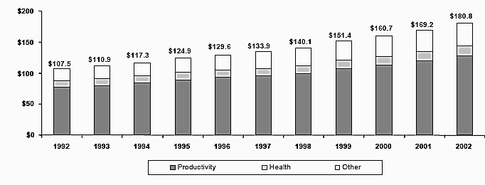
Highest Cost to Society
Surgeon General’s Report, 2004: ONDCP; Harwood, 2000
Notes:
The largest proportion of cost is from lost potential productivity followed by non-health other costs and then health care costs
71% productivity – reflects the loss of potential resources, work in the labor market and in household that was never performed but could easily have been expected to have been performed absent the impact of drug abuse
Other 20% -- Criminal Justice system, federal corrections (operations of prison systems), crime victim costs, and administration of the social welfare system
health care cost 8.7% -- The big contributors have HIV and community-based treatment.

Slide 7
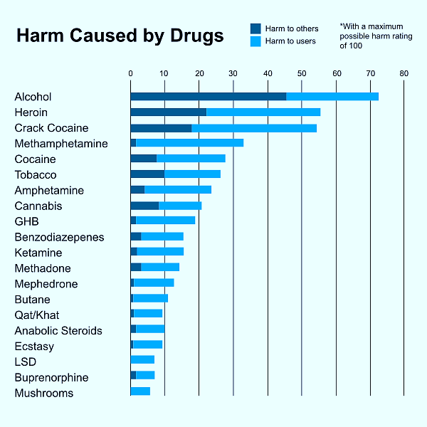
Substance Abuse Harm to Patients
D Nutt, L King, L Phillip. Drug harms in the UK: a multi-criteria decision analysis. of the Independent Scientific Committee on Drugs. The Lancet. November 2011
Notes:
A table from a research study of the harms caused by drugs found alcohol to be the most harmful.

Slide 8
Consequences that matter to Hospitals Substance Abuse Complications
Smoking related complications
Necrosis was 4 times more frequent in smokers
Surgical site infection, dehiscence, healing delay, hernia, and lack of fistula and bone healing occurred 2 times more frequently in smokers
Perioperative smoking cessation intervention including 4 to 8 weeks of preoperative abstinence from smoking significantly reduced surgical site infections but not other healing complications
LT. Sorensen. Wound Healing and Infection in Surgery: The Clinical Impact of Smoking and Smoking Cessation: A Systematic Review and Meta-analysis Arch Surg. 2012;147(4):373-383
Alcohol Related | Low Audit C | High Audit C
Post Operative Hospital LOS | 5.0 | 5.8
ICU days | 2.8 | 4.5
Probability of return to OR w/in 30 days | 5% | 10%
Bradley et al. Alcohol Screening and Risk of Postoperative Complications in Male Patients Undergoing Major Non-cardiac Surgery. J Gen Intern Med 2011 February; 26 (2): 162-169

Slide 9
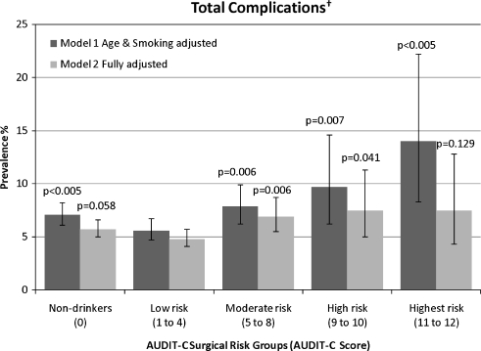
Consequences that matter to Hospitals Alcohol Complication Rates
Bradley et al. Alcohol Screening and Risk of Postoperative Complications in Male Patients Undergoing Major Non-cardiac Surgery. J Gen Intern Med 2011 February; 26 (2): 162-169
Notes:
AUDIT-C scores of 5 or more up to a year before surgery were associated with increased postoperative complications. The proportions of subjects
who were rehospitalized or visited the ED were also higher

Slide 10
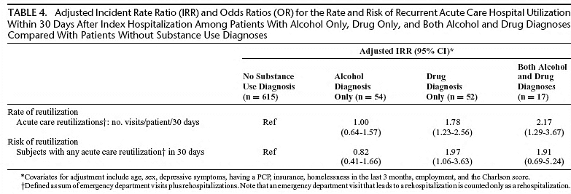
Consequences that matter to Hospitals Substance Use & Reutilization
Walley et al. Acute care Hospital Utilization Among Medical Inpatients Discharged With a Substance Use Disorder Diagnosis.. J Addict Med 2012;6:50-56.
Notes:
Subjects with substance use disorders had higher rates of acute care service reutilization, including ED visits and
Re-hospitalizations, at 30 days.

Slide 11
Public Health Challenge? Definitely Now a challenge for Hospitals?
Hospitalization provides a propitious opportunity to deliver interventions for all substance abuse
At least 2.5 million of the 35 million patients that get admitted to US hospitals annually have serious alcohol and drug problems that go untreated.
Approximately 25% of all persons admitted to general hospitals have alcohol use disorders or are being treated for the consequences of their drinking, making hospitalization a potentially opportune time for interventions to reduce unhealthy alcohol use (Smothers et al., 2003) and 21% of our population uses tobacco (CDC)
Soderstrom et al. (1992) found that 67% of trauma patients who had a positive BAC met criteria for alcohol dependence and an additional 46% of those with a negative BAC also met dependence criteria.
Notes:
First, many tobacco users are hospitalized because of a tobacco-caused disease (e.g., chronic obstructive pulmonary disease, cardiovascular diseases, cancer, or infections), making the need to stop the use of tobacco particularly salient.
Second, most U.S. hospitals are now smoke-free, and many have smoke-free campuses, which makes smoking during hospitalization difficult and inconvenient and therefore encourages cessation.
Third, evidence-based treatments could be made readily available in hospital settings, allowing hospitalized patients to receive expert advice on how to quit smoking and information on how their diseases and symptoms are related to tobacco use. Patients could also directly experience the mitigation of withdrawal symptoms provided by tobacco-cessation medications during forced abstinence in a hospital. The Joint Commission’s New Tobacco-Cessation Measures - Will Hospitals Do the Right Thing?

Slide 12
Tobacco Public Health Impact

Slide 13
WHY SBIRT: Alcohol & Drug Impact Morbidity and Mortality
Study | Results - Conclusions | Reference
Trauma Patients | 40% fewer re-injury (10 Months) 50% less likely to re-hospitalize | Gentilello et al, 1999
Hospital ER Screening | Reduction DUI arrests 1 DUI arrest prevented for 9 screens | Schermer et al, 2006
Physician offices | 20% fewer motor vehicle crashes over 48 months follow-up | Fleming et al, 2002
Meta-Analysis | Interventions Reduced Mortality | Cuijpers et al, 2004
Meta-Analysis | Treatment reduced alcohol, drug use Positive social outcomes: Substance-related work or academic impairment, physical symptoms ( memory loss, injuries), or legal problems (DUI) | Burke et al, 2003
Meta-Analysis | Interventions can provide effective public health approach to reducing risky use | Whitlock et al, 2004
Eric Goplerud, Ph.D. Senior Vice President Director, Substance Abuse, Mental Health and Criminal Justice Studies

Slide 14
SBIRT Impact on Economic Cost
Study | Cost Savings | Reference
Randomized trial of brief treatment in the UK | Reductions in one-year healthcare costs $1.00 spent in intervention = $2.30 saving | UKATT, 2005
TREAT (Trial for Early Alcohol Treatment) Randomized clinical trial: Screening, brief counseling in 64 primary care clinics of nondependent alcohol misuse | Reductions in future healthcare costs $1.00 spent in intervention = $4.30 saving (48-month follow-up) | Fleming et al, 2003
Randomized control trial of SBI in a Level I trauma center Alcohol screening and counseling for trauma patients (>700 patients). | Reductions in medical costs $1.00 spent in intervention = $3.81 saving | Gentilello et al, 2005
Eric Goplerud, Ph.D. Senior Vice President Director, Substance Abuse, Mental Health and Criminal Justice Studies
Notes:
BSI improves employee health and benefits employers, because it ...
• Increases smoking quit rates from 3% to 28%
• Decreases ED visits by 20% and hospitalizations by 37% by reducing binge drinking

Slide 15
Other Driving Forces
ACS (American College of Surgeons)
Level I & II Trauma Centers (271)
Criteria Deficiency: “The trauma center does not have a mechanism to identify patients who are problem drinkers”
Level I Trauma Hospitals (203)
Criteria Deficiency: “ The trauma center does not have the capability to provide intervention or referral for patients identified as problem drinkers”
COT Resources for Optimal Care of the Injured Patient 2006 –
Veterans Health Administration (VA)
Mandatory screening for risky alcohol use with AUDIT-C

Slide 16
TJC Joint Commission for Accreditation of Health Care Orgs
Hospital-based inpatient psychiatric services (HBIPS)
Mandatory reporting for 320 psychiatric hospitals since 2011
Optional for general hospitals with psychiatric units
HBIPS 1 – includes alcohol and drug screening
TJC: Substance Use Measures
Expectations for CMS IPPS 2014
4 hospital tobacco and 4 substance use SBIRT measures
Adopted by TJC 2011 as reportable measure sets for accreditation

Slide 17
The Joint Commission Measures
SBIRT SUB 1: Substance Use
Hospitalized patients who are screened during the hospital stay using a validated screening questionnaire for unhealthy alcohol use
SBIRT SUB 2: Substance Use
Patients who screened positive for unhealthy alcohol use who received or refused a brief intervention during hospital stay
2a – Patients who received a brief intervention during hospital stay
SBIRT SUB 3: Substance Use
Patients who are identified with alcohol or drug use disorder who receive or refuse at discharge a prescription for FDA-approved medications for alcohol or drug use disorder, OR who receive or refuse a referral for addictions treatment
3a – Patients who are identified with alcohol or drug disorder who receive a prescription for FDA-approved medications for alcohol or drug use disorder OR a referral for addictions treatment
SBIRT SUB 4: Substance Use
Discharged patients who screened positive for unhealthy alcohol use or who received a diagnosis of alcohol or drug disorder during their inpatient stay, who are contacted within 30 days after hospital discharge and follow-up information regarding their alcohol or drug use status post discharge is collected
Adopted by TJC in 2011 as reportable measure set for accreditation

Slide 18
The Joint Commission Measures
TOB 1,2,3&4: Tobacco Treatment Measures:
Tobacco use screening, treatment provided or offered during hospital stay, at discharge, and assessment of status post discharge
NQF (National Quality Forum) review 2012
Pushing for implementation through TJC
TJC requesting additional data to support measures
Additional data submitted fall 2012
CMS Inpatient Prospective Payment System Rule (IPPS)
“Once the e-specifications and the HER-based collection mechanism are available for the smoking and alcohol cessation measures developed by TJC, we intend to propose two TJC smoking and alcohol cessation measure sets for inclusion in the Hospital IQR Program.” (p.715)

Slide 19
Potential Revenue Generation
15,000 patient admission per year, currently
85% capture rate,(12,750 patients)
Potential revenue of $446,000 annual for assessments (Facility Resource Charge)
100,636 billing for interventions
(22% of inpatients screen positive and 5% for 2 or more measures
http://hospitalsbirt.webs.com/webinars.htm
Implementing SBIRT in Emergency Departments presented by Steve O'Neil
Plan | Tobacco |  |  | Alcohol/Drugs
 | Assess | Int 3-10min | Int > 10 min | Assessment | Intervention 15-30 min | Intervention > 30 min
Commercial | 0 | 99406 -- $15 | 99407 -- $30 | 99420 -- $35.35 | 99408 -- $33 | 99409 -- $66
Medicare | 0 | 99406 --$14 | 99407 -- $29 |  | G0396 -- $30 | G0397 -- $58
Medicaid | 0 | 99406 --$11 | 99407 -- $22 | 99420 -- $35.35 | H0049 -- $35 | H0050 --$20
Physician |  |  |  |  | 99408 – 0.65 RVU | 99409 – 1.3 RVU
Notes:
Alcohol, drugs, and increasingly, prescription drug use are crowding Emergency Departments
Expensive ED visits, especially for uncompensated care and returning ED visits by uninsured

Slide 20
Implementation
Develop a broad committee: Get the buy-in at all levels
Include IS, EMR builders & report writers , trauma service, staff providing SBIRT services, and your administrative & clinical champions
Develop a vision for your program
SBIRT services provided by Physicians, associate, or ancillary staff
Assure program implemented affects patient change
Assure assessment, intervention, an follow up are tractable in EMR for ACS & TJC standards
Assure inpatient and outpatient record integration

Slide 21
Gundersen Lutheran In Patient Hospital Program Cost
Program implemented with no additional FTE
Assessment responsibilities shifted from Wellness Specialist to nursing admission process
Collaboration with Exercise Physiology previously completing smoking cessation only
Expanded to all hospital inpatients 365 days per year to include smoking, alcohol, and illicit drug use

Slide 22
Gundersen Lutheran Health System Rural WI tertiary ACS Level II Trauma Center
Wellness Consult order on all admissions
15,ooo+ annual admissions, assessment completed by admitting RN and recorded in EMR on Patient Profile
85% assessment capture rate
Daily report to identify positive and incomplete assessments
Wellness Specialists complete intervention, consult note, submit billing, and establish follow up for positive screens
90% capture rate of positive screens
90% billing rate, time limitations for billing
Consult note forwarded to attending physician for notification and reinforcement of plan
Follow up @ 1 week, 1 month, 6 months, and 1 year by initial provider
Notes:
Excluded, head injuries, deaths

Slide 23
Gundersen Lutheran Program Results
Total eligible Positive Screens | 1790 | Percentage
Agreed to 1 week follow up | 420 | 24%
Reached with 3 attempts | 318 | 76%
Positive change | 232 | 73%
Agreed to 1 month follow up | 227 | 98%
Reached with 3 attempts | 156 | 69%
Positive change | 96 | 62%
Agreed to 6 month follow up | 126 | 81%
Notes:
Concern is the 24% follow up rate
Review of process by providers revealed different mannerisms when asking for follow up consent
“I like the plan we have developed, is it ok if I call you in a week and see how you are
versus
“Can I call you in a week or provide you with these educational materials to help you with your plan? “

Slide 24
Denver Health Results April 2007 and April 2011 Services provided to 52,805 patients

Slide 25
Gundersen Lutheran Health System
The greatest benefit of this service is for the patients of the communities we serve; as 48% of our trauma population requires interventions for alcohol and/or illicit drugs and 27% of inpatients screen positive for tobacco, alcohol and/or illicit drug use.
Trauma Systems have led many facility initiatives
SBIRT is one more opportunity
Notes:
19 regional clinics and 2 small level IV WI classified trauma Centers

Slide 26
?
Thank you!

