Slide 1
Screening for High Risk and Dependent Alcohol Use among Psychiatric Inpatients
The Joint Commission’s SUB-1
Eric Goplerud, Ph.D.
Senior Vice President
Director, Substance Abuse, Mental Health and Criminal Justice Studies
goplerud-eric@norc.org
301-634-9525

Slide 2
Screening for Alcohol Use among Psychiatric Inpatients
Screening refers to a tool – usually a brief questionnaire – that finds subjects who have or are at high risk for a disorder in a population of interest.
Screening does not establish a diagnosis. Instead, it identifies people at risk for or likely to have a disorder
The Joint Commission SUB-1 measure specifies a “validated” screening instrument

Slide 3
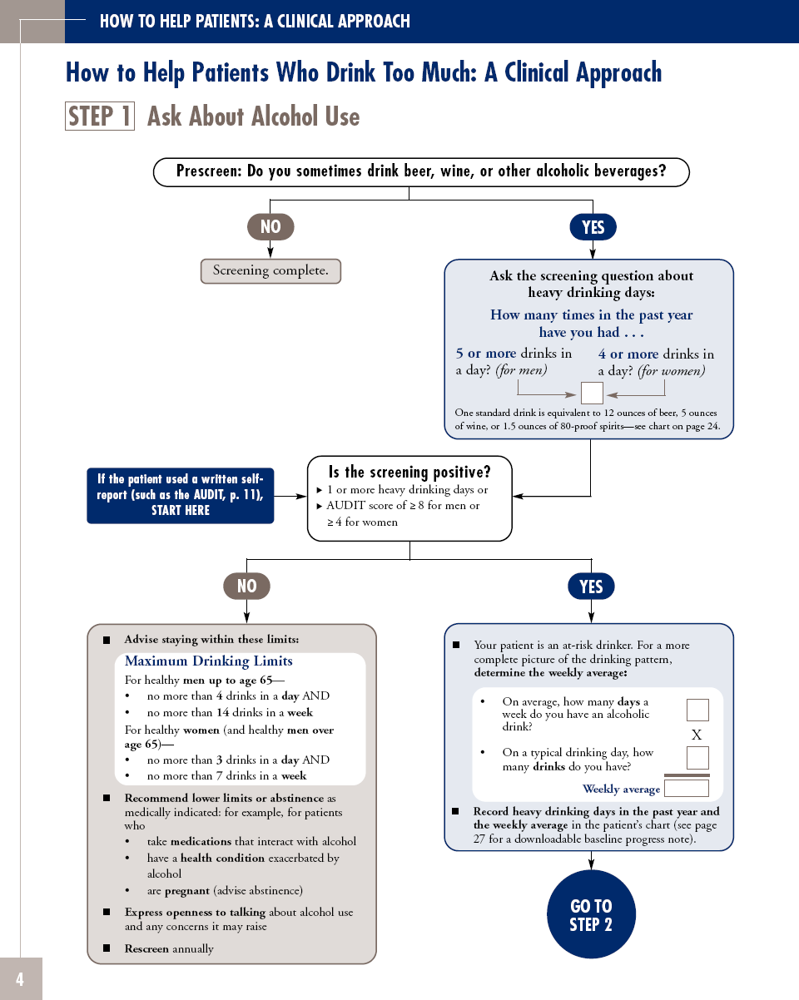
HOW TO HELP PATIENTS: A CLINICAL APPROACH
STEP 1:
Ask About Alcohol Use
Prescreen: Do you sometimes drink beer, wine, or other alcoholic beverages?
  If NO… the screening is complete.
  If YES…
Notes:
HOW TO HELP PATIENTS: A CLINICAL APPROACH
STEP 1: Ask About Alcohol Use
Prescreen: Do you sometimes drink beer, wine, or other alcoholic beverages?

Slide 4
Pre-Screen: The NIAAA – Recommended Single Question Alcohol Screener
 | None | 1 or more
MEN: How many times in the past year have you had 5 or more drinks in a day?
WOMEN: How many times in the past year have you had 4 or more drinks in a day?
This question was sensitive (87.9%) but less specific (66.8%) for the detection of a current alcohol use disorder.
  Smith PC, Schmidt SM, Allensworth-Davies D, Saitz R. Primary care validation of a single-question alcohol screening test. J Gen Intern Med. 2009;24:783–788.
Supplemented by two-item screener: (1) recurrent drinking in hazardous situations and (2) drinking more than intended. If either answered yes, the sensitivity of current SUD varies from 77% to 95% and the specificity from 62% to 86%.
          Vinson DC, Kruse RL, Seale JP. Simplifying alcohol assessment: two questions to identify alcohol use disorders. Alcohol Clin Exp Res. 2007;31:1392–1398.

Slide 5
Why We Recommend the AUDIT
Valid
Reliable
Brief
Public domain
Free
Multiple languages
Widely used in the U.S. and Canada
Identifies unhealthy and dependent drinking patterns
Results guide treatment
Monitors change in use
Fits with other screeners (e.g. PHQ-9 for depression)
Multiple ways to administer (verbally, in person or over the phone, on paper or online)

Slide 6
HOW TO HELP PATIENTS: A CLINICAL APPROACH
STEP 1:
Is the Screening Positive?
Positive Screening =
  1 or more heavy drinking days
Notes:
STEP 1 continued:
If the patient used a written self-report (such as the AUDIT), start here.
Is screening positive?
1 or more heavy drinking days, or
AUDIT score of ≥ 8 for men or ≥ 4 for women

Slide 7
HOW TO HELP PATIENTS: A CLINICAL APPROACH
If YES…
Ask the screening question about heavy drinking days:
How many times in the past year have you had…
5 or more drinks in a day? (for men)
4 or more drinks in a day? (for women)
?
Notes:
STEP 1 (Cont’d):
Following the Prescreen…
If the answer is “NO” - then the screening is complete.
If the answer is “YES” - Ask the screening question about heavy drinking days…
How many times in the past year have you had….
…5 or more drinks in a day? (men)
…4 or more drinks in a day? (women)
TIP: it may be useful to show patients the STANDARD DRINKS chart on page 24 in the Guide.

Slide 8
How much is a drink?

Slide 9
HOW TO HELP PATIENTS: A CLINICAL APPROACH
STEP 1: Is the Screening Positive?
If NO then…
Advise staying within these limits:
Maximum Drinking Limits
  For healthy men up to age 65—
  no more than 4 drinks in a day AND
  no more than 14 drinks in a week
  For healthy women (and healthy men over age 65)—
  no more than 3 drinks in a day AND
  no more than 7 drinks in a week
Notes:
STEP 1 (continued): Is the screening positive?
If NO, then …
Advise staying within these limits: Maximum Drinking Limits
For healthy men up to age 65—
…No more than 4 drinks in a day AND
…No more than 14 drinks in a week
For healthy women (and healthy men over age 65)—
…no more than 3 drinks in a day AND
…no more than 7 drinks in a week

Slide 10
HOW TO HELP PATIENTS: A CLINICAL APPROACH
STEP 1: Is the Screening Positive?
If YES then…
Your patient is an at-risk drinker. For a more complete picture of the drinking pattern, determine the weekly average:
On average, how many days a
week do you have an alcoholic drink?
On a typical drinking day, how
many drinks do you have?
x
Weekly Average
Notes:
STEP 1 (continued):
Is the screening positive?
YES if the patient’s response reflected
1 or more heavy drinking days or
an AUDIT score of ≥ 8 for men or ≥ 4 for women
Your patient is an at-risk drinker. For a more complete picture of the drinking pattern, determine the weekly average with the following questions:
* On average, how many days a week do you have an alcoholic drink?
* On a typical drinking day, how many drinks do you have?
Multiply the responses to determine the weekly average.
Record heavy drinking days in the past year and the weekly average.
To download preformatted progress notes and templates, go online to www.niaaa.nih.gov/guide (See details on page 27).
GO TO STEP 2

Slide 11
Using the AUDIT –C: Consumption Questions
Questions | 0 | 1 | 2 | 3 | 4 | Score
1. How often do you have a drink containing alcohol? | Never | Monthly or less | 2-4 times per month | 2-3 times per week | 4 or more times per week
2. How many drinks containing alcohol do you have on a typical day of drinking? | 1 or 2 | 3 or 4 | 5 or 6 | 7 to 9 | 10 +
3. How often do you have 5 (for men under age 65)/4 (for women and men over age 65) or more drinks on one occasion? | Never | Less than monthly | Monthly | Weekly | Daily or almost daily
AUDIT-C Score (add items 1-3) Positive screen = 4 for men/3 for women and men over age 65. If positive, ask the next 7 questions to administer the full AUDIT.

Slide 12
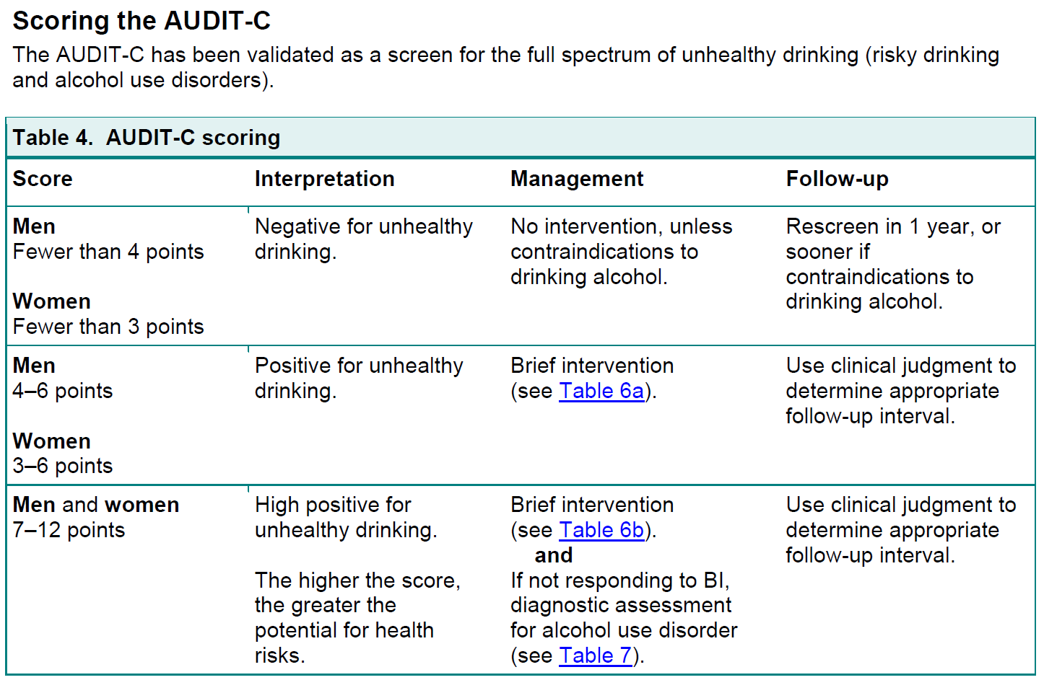

Slide 13
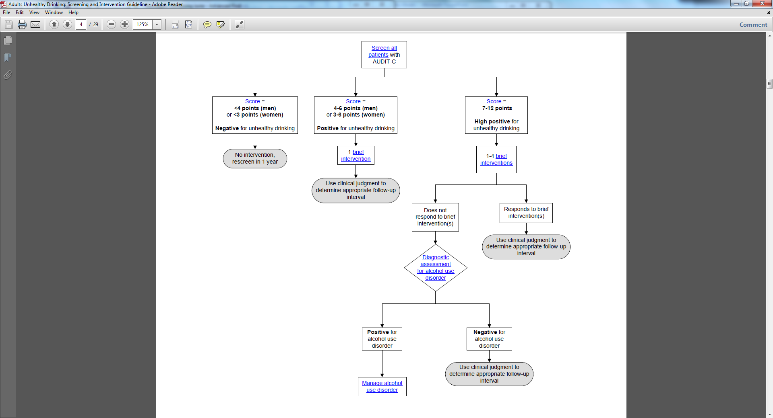
AUDIT-C Intervention guide
From Group Health of Puget Sound

Slide 14
AUDIT-PC: Consumption, Problems – predicts hospital withdrawal risk
Questions | Scoring system |  |  |  |  | Your score
 | 0 | 1 | 2 | 3 | 4
How often do you have a drink containing alcohol? | Never | Monthly or less | 2 - 4 times per month | 2 - 3 times per week | 4+ times per week
How many units of alcohol do you drink on a typical day when you are drinking? | 1 -2 | 3 - 4 | 5 - 6 | 7 - 9 | 10+
How often during the last year have you found that you were not able to stop drinking once you had started? | Never | Less than monthly | Monthly | Weekly | Daily or almost daily
How often during the last year have you failed to do what was normally expected from you because of your drinking? | Never | Less than monthly | Monthly | Weekly | Daily or almost daily
Has a relative or friend, doctor or other health worker been concerned about your drinking or suggested that you cut down? | No |  | Yes, but not in the last year |  | Yes, during the last year
Scoring:
A total of 5+ indicates increasing or higher risk drinking.
An overall total score of 5 or above is AUDIT-PC positive.

Slide 15
Remaining AUDIT Questions
Questions | Scoring system |  |  |  |  | Your score
 | 0 | 1 | 2 | 3 | 4
How often have you had 6 or more units if female, or 8 or more if male, on a single occasion in the last year? | Never | Less than monthly | Monthly | Weekly | Daily or almost daily
How often during the last year have you needed an alcoholic drink in the morning to get yourself going after a heavy drinking session? | Never | Less than monthly | Monthly | Weekly | Daily or almost daily
How often during the last year have you had a feeling of guilt or remorse after drinking? | Never | Less than monthly | Monthly | Weekly | Daily or almost daily
How often during the last year have you been unable to remember what happened the night before because you had been drinking? | Never | Less than monthly | Monthly | Weekly | Daily or almost daily
Have you or somebody else been injured as a result of your drinking? | No |  | Yes, but not in the last year |  | Yes, during the last year

Slide 16
Other Screening Instruments
Adolescents: CRAFFT
Geriatric – MAST-G
Alcohol and other Drugs – ASSIST
Behavioral health and AUDs – GAIN-SS
SIP-A
ASI – Alcohol Subscale
CAGE?
Notes:
Source: Ewing JA. (1984). Detecting alcoholism: The CAGE questionnaire. JAMA, 252, 1905-1907.
Source: World Health Organization (2003). The Alcohol Smoking and Substance Involvement Screening Test (ASSIST): Guidelines for Use in Primary care (Draft Version 1.1 for Field Testing). Geneva, Switzerland.

Slide 17
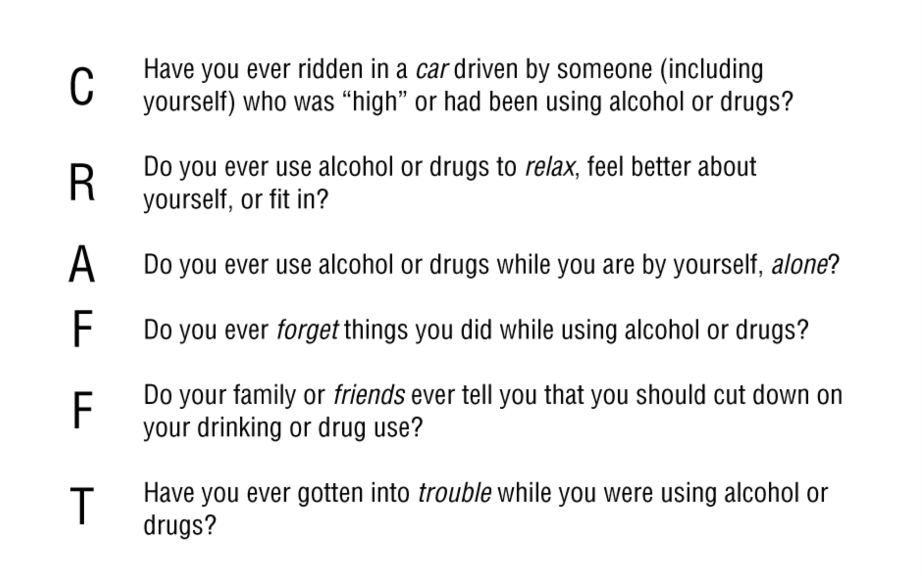
Adolescent Screener: CRAFFT
Arch Pediatr Adolesc Med. 2002;156(6):607-614. doi:10.1001/archpedi.156.6.607

Slide 18
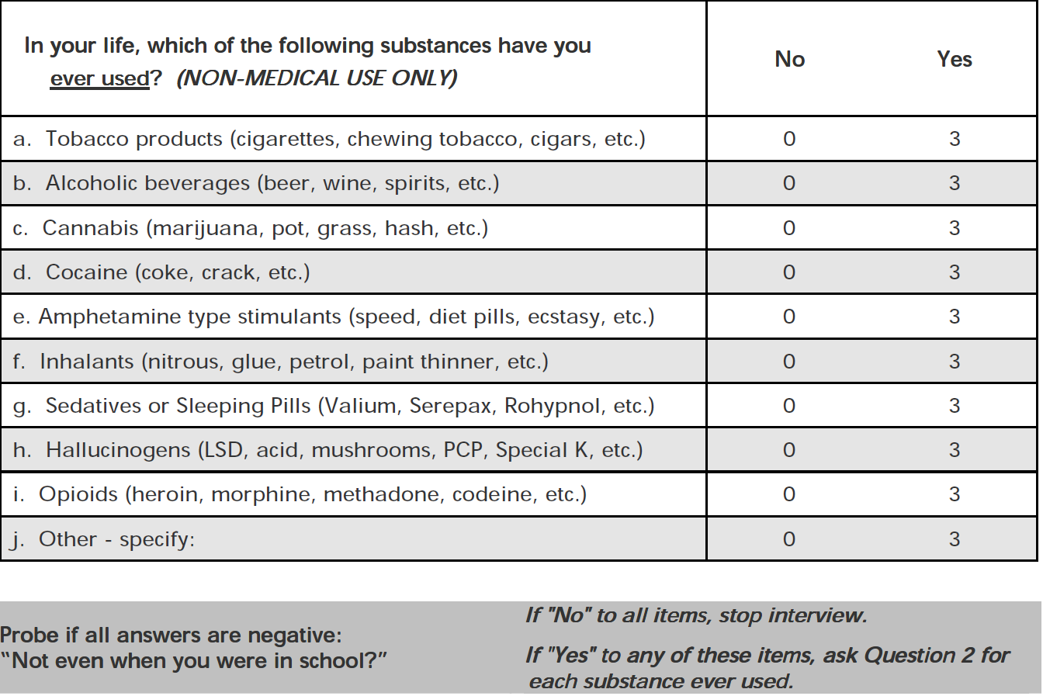
The ASSIST - Alcohol, Smoking and Substance Involvement Screening Test (WHO)
http://www.who.int/substance_abuse/activities/assist/en/

Slide 19
Global Appraisal of Individual Needs Short Screener (GAIN-SS) -- Substance Use Scale
When was the last time that…
you used alcohol or other drugs weekly or more often?
you spent a lot of time either getting alcohol or other drugs, using alcohol or other drugs, or recovering from the effects of alcohol or other drugs (e.g., feeling sick)?
you kept using alcohol or other drugs even though it was causing social problems, leading to fights, or getting you into trouble with other people?
your use of alcohol or other drugs caused you to give up or reduce your involvement in activities at work, school, home, or social events?
you had withdrawal problems like shaky hands, throwing up, having trouble sitting still or sleeping, or used to stop being sick?
Dennis, M. L., Chan, Y. F., & Funk, R. R. (2006). Development and validation of the GAIN Short Screener (GSS) for internalizing, externalizing and substance use disorders and crime/violence problems among adolescents and adults. The American Journal on Addictions, 15(s1), s80-s91.

Slide 20
SIP-A Short Index of Problems - Alcohol
I have been unhappy because of.. | I had money problems because of
I have not eaten properly because of | My physical appearance was harmed by
I failed to do what was expected because of | My family was hurt by
I felt guilty because of | My friendships have been damaged by
I have taken foolish risks because of | Alcohol has gotten in the way of my growth
I have done impulsive things when | Alcohol damaged my social life
My physical health was harmed by | I spent too much time because of
I have had an accident while.
Feinn R, Tennen H, Kranzler HR. Psychometric properties of the Short Index of Problems as a measure of recent alcohol-related problems. Alcsm Clin Exp Res. 2003;27:1436–41Alterman AI, Cacciola JS, Ivey MA, Habing B, Lynch KG. Reliability and validity of the alcohol SIP and a newly constructed drug Short Index of Problems. J Stud Alcohol Drugs. 2009;70:304–7

Slide 21
Addiction Severity Index – 6; Alcohol Scale
Drank more/longer than intended | Time spent drinking
Impaired control (stop/cut down) | Use despite interpersonal problems
Hazardous use | Failure to fulfill role obligations
Withdrawal | Activities given up
Tolerance | Legal problems
Use despite physical/psychological problems
Cacciola, J. S., Alterman, A. I., Habing, B., & McLellan, A. T. (2011). Recent status scores for version 6 of the Addiction Severity Index (ASI‐6). Addiction, 106(9), 1588-1602.

Slide 22
CAGE – not recommended, insensitive to risky use
(1) “Have you ever felt you ought to Cut down on your drinking?”;
(2) “Have people Annoyed you by criticizing your drinking?”;
(3) “Have you ever felt bad or Guilty about your drinking?”; and
(4) “Have you ever had a drink in the morning to steady your nerves or get rid of a hangover (Eye opener)?”.
One positive response should raise the possibility of alcohol-related problems, but most researchers have used two or more positive responses. A pooled analysis of the CAGE in screening for alcohol abuse and dependence found a sensitivity of 0.87 in inpatients. Binge drinking and high risk use are often not captured by the CAGE.

Slide 23
SUB-1 Training www.SBIRTmentor.com
SBIRTmentor
• Self-directed and convenient: complete at work, home or on the road with unlimited 24/7 availability
• Easy to use: immediate access with a few mouse clicks
• Screening and brief intervention practice with simulated patients in hospital situations
• Immediate feedback from standardized patients and skill acquisition scores
3 CMEs, continuing nurse education and counselor, social work, psychology CEUs
• For more information, 303.369.0039 x245 or
SBIRTinfo@PeerAssist.org
• To access visit www.SBIRTmentor.com

Slide 24
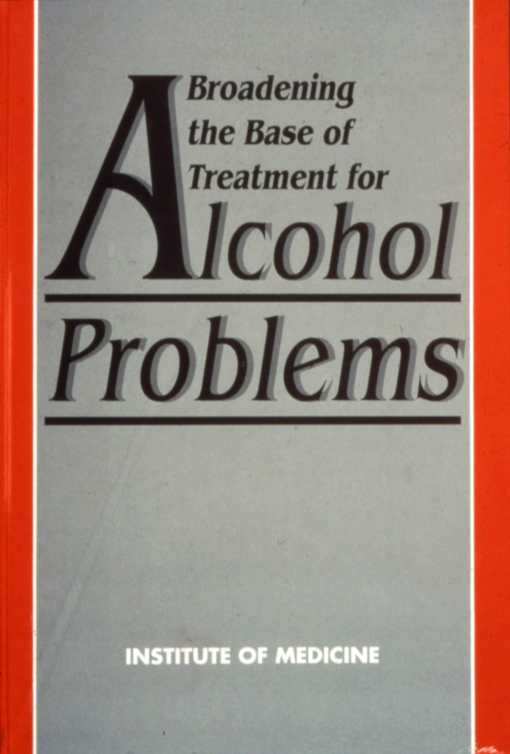
Has enough time passed for SBI?
“Suitable methods of identification and readily learned brief intervention techniques with good evidence of efficacy are now available. The committee recommends… broad deployment of identification and brief intervention.”
  1990 (23 years ago!)
  (IOM, Broadening the Base of Treatment for Alcohol Problems, 1990, p. 8)

Slide 25
Eric Goplerud Senior Vice President
  Substance Abuse, Mental Health and Criminal Justice Studies
  NORC at the University of Chicago
  4350 East West Highway 8th Floor, Bethesda, MD 20814
  goplerud-eric@norc.org | office 301-634-9525 | mobile 301-852-8427

